Slide 1
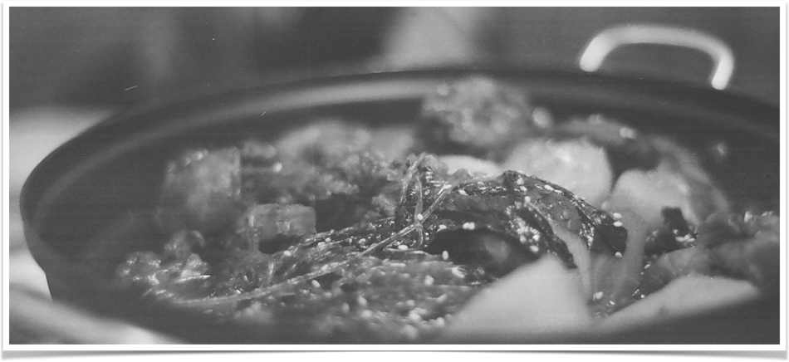
Our Meal
Web&App Project
KIM MIN JUN
KIM JONG HYUN
KIM HWA RANG
PARK CHAN SEON
LIM CHIE WANG
By Java King

Slide 2
Index
WEB
Why Our Meal ?
Reference Site
Resource
Structure Map
Database Design
Function
App

Slide 3

Web&App Project
Why
?
Our Meal
?
By Java King

Slide 4
Web&App Project
Why
?
Our Meal
By Java King
Store Promotion
Communication
with customers
An Increase In Profits
Partner
OurMeal
User
Easy Information
Famous Restaurant
Delicious Food
Photo
Provide Information

Slide 5

WEB Reference site
Web&App Project
Our Meal
By Java King
(http://www.baemin.com/)

Slide 6
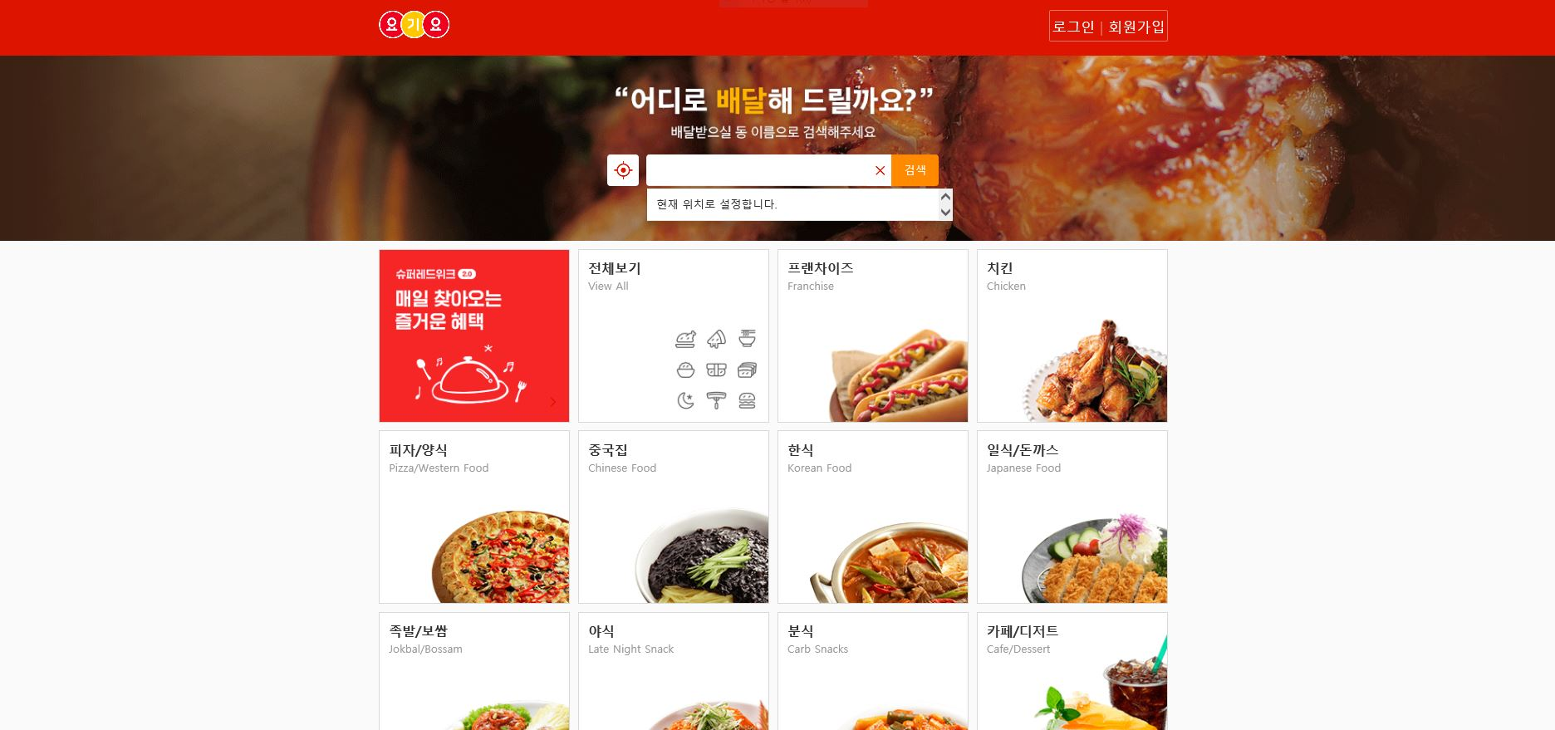
WEB Reference site
Web&App Project
Our Meal
By Java King
(https://www.yogiyo.co.kr/mobile/#/)

Slide 7
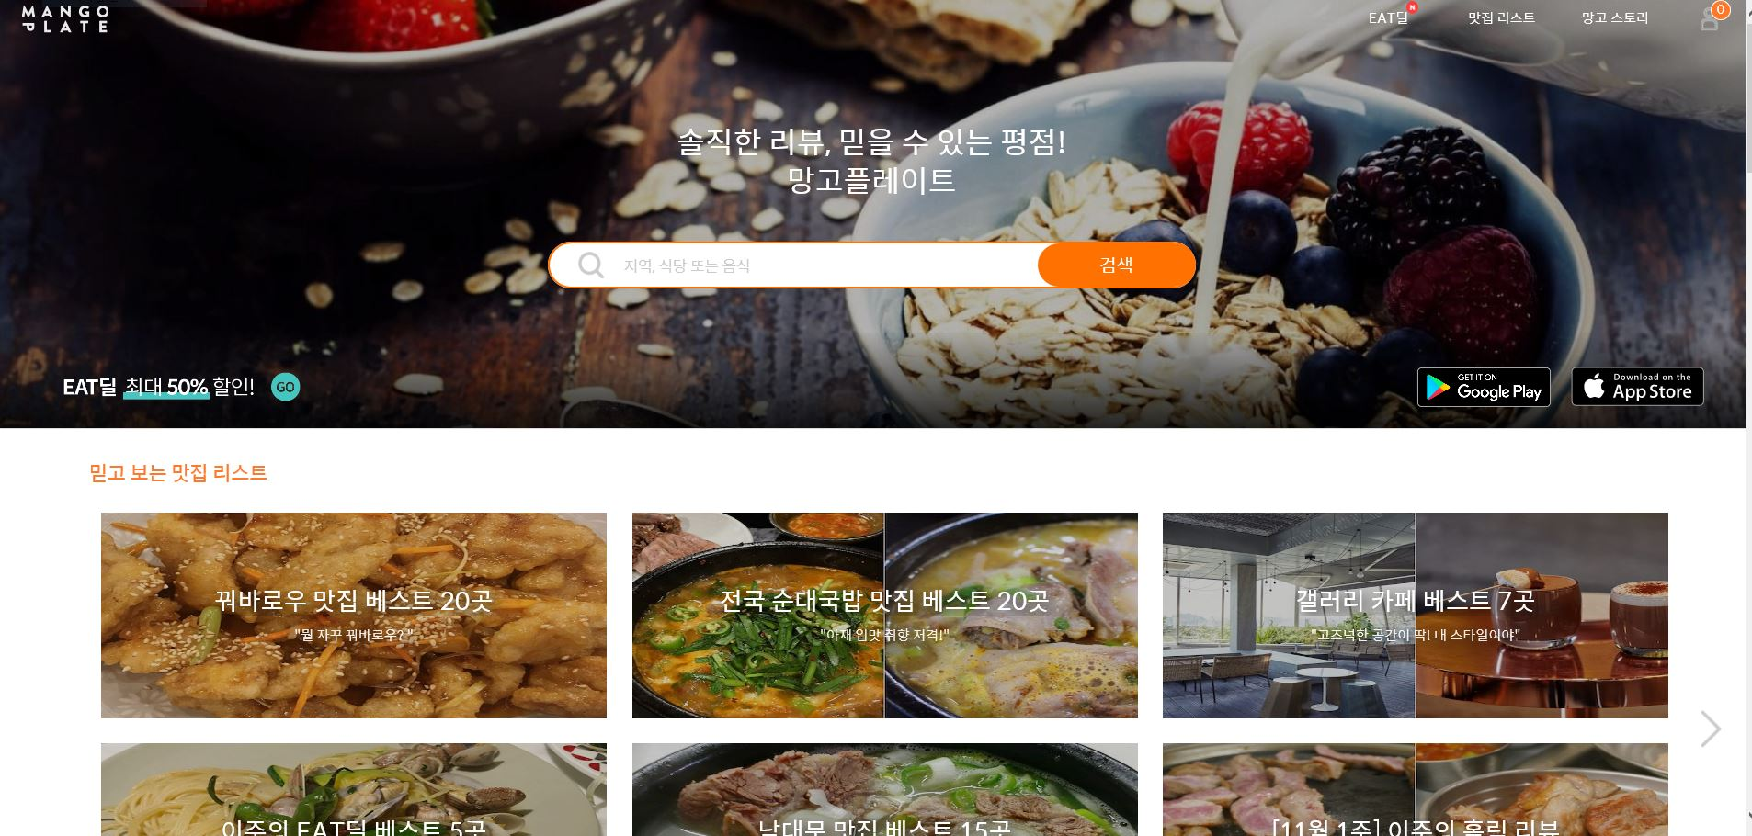
WEB Reference site
Web&App Project
Our Meal
By Java King
(http://www.mangoplate.com/)

Slide 8
WEB Resource
Web&App Project
Our Meal
By Java King
OS
Windows 10 Pro
WAS
Apache Tomcat 9.0
DBMS
MySQL Server 8.0
Language
Java Platform10, JSP & Servlet
Framework
Spring, Mybatis
WEB
HTML 5 , CSS/CSS3, JavaScript, Ajax
Tool
Eclipse Java EE IDE
Open
Source
JavaScript jquery-3.3.1.min, BootStrap,
Naver Map API, Juso API ...

Slide 9
WEB Structure Map
Web&App Project
Our Meal
By Java King
Our Meal
NonMember
Member
Partner
Admin
Select Menu
Search Menu
Join Membership
Board
Store
Information
Notice Board
Free Board
Food Information
Review

Slide 10
WEB Structure Map
Web&App Project
Our Meal
By Java King
Our Meal
NonMember
Member
Partner
Admin
Login
Find Password
Select Menu
Search Menu
Board
Customer
Service
My Page
Store
Information
Basic Information
Notice Board
Free Board
Q&A
Food Information
Health Information
Online Consultation
Review
Withdrawal

Slide 11
WEB Structure Map
Web&App Project
Our Meal
By Java King
Our Meal
NonMember
Member
Partner
Admin
Login
Find Password
Store
Page
Customer
Service
Member
Store
Information
Q&A
Review
Online Consultation

Slide 12
WEB Structure Map
Web&App Project
Our Meal
By Java King
Our Meal
NonMember
Member
Partner
Admin
Login
Member
Partner
Store
Board
Service

Slide 13
Database Design
Web&App Project
Our Meal
By Java King

Slide 14
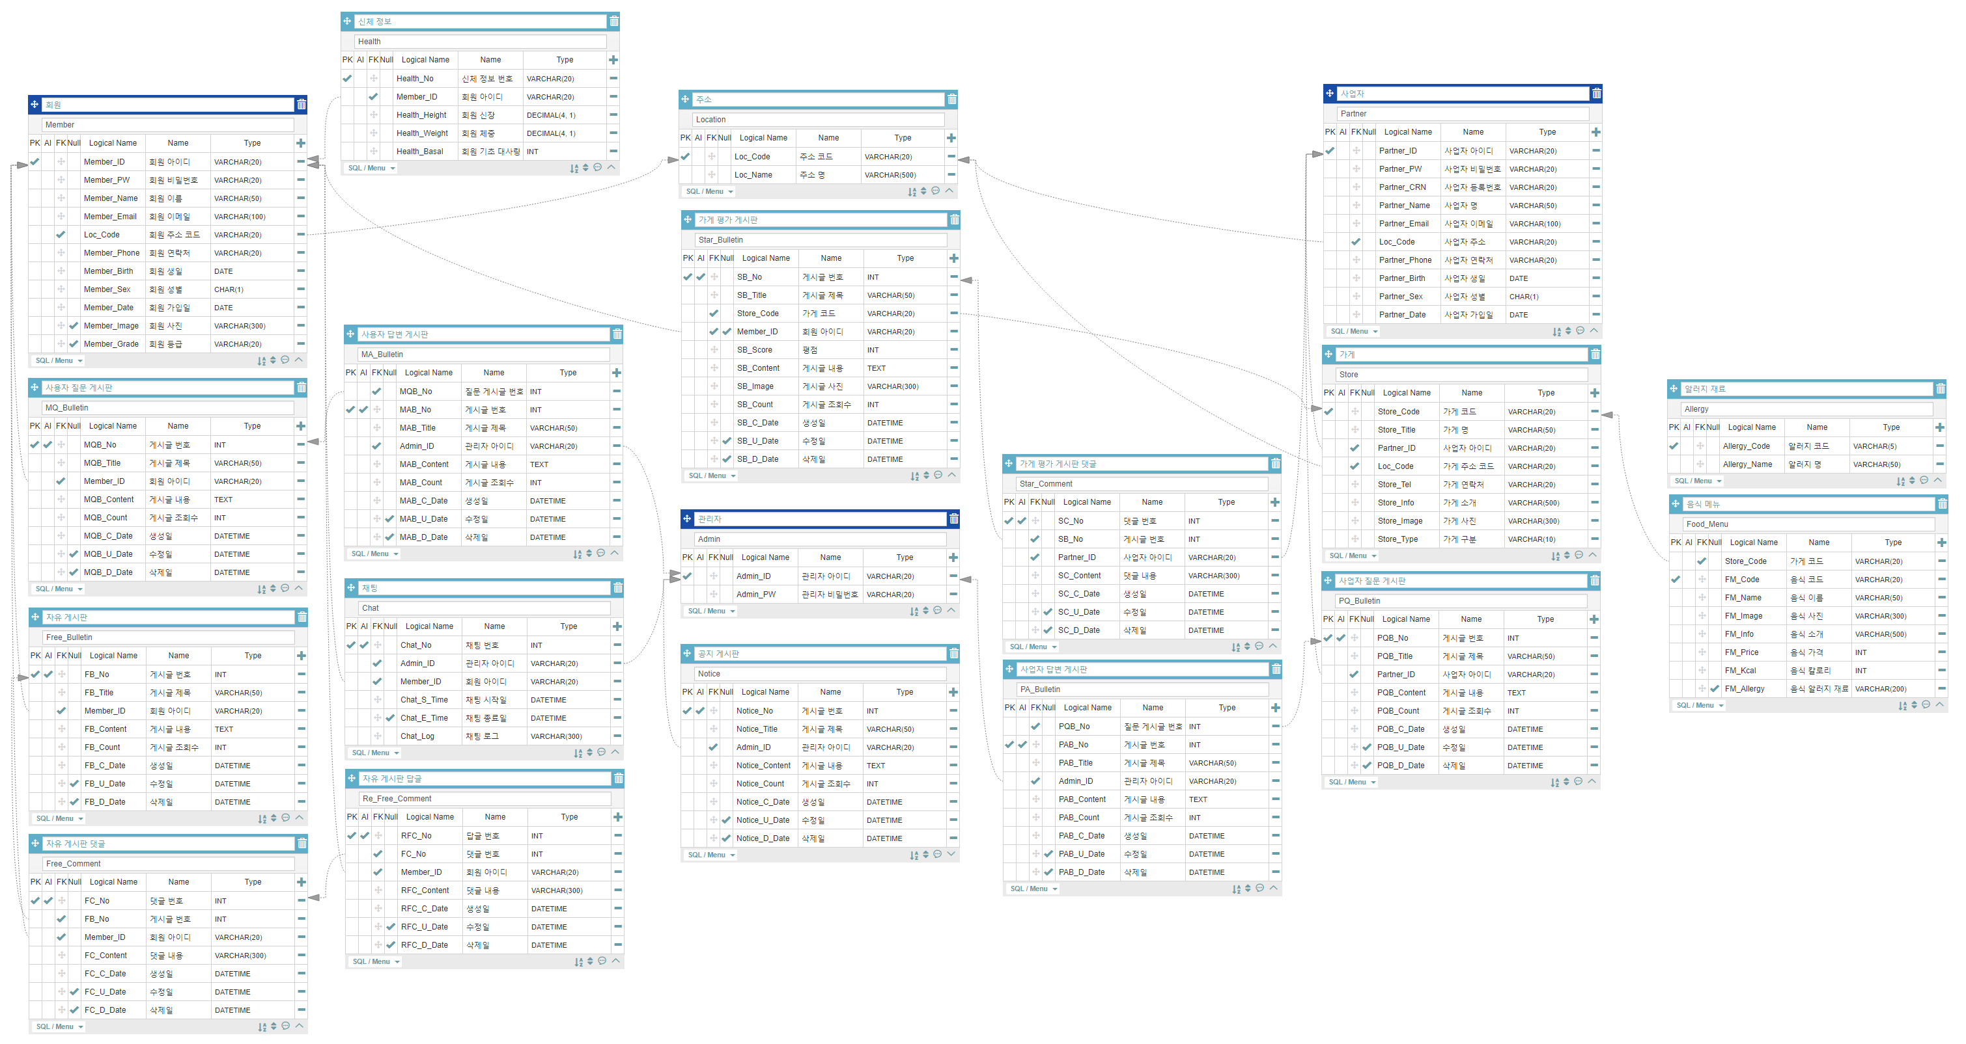
Table : 19 → 25

Slide 15

Database Design
Web&App Project
Our Meal
By Java King
Member
Store
Board
Review
Partner
Contents
Food
Admin
Location Code
Comment

Slide 16
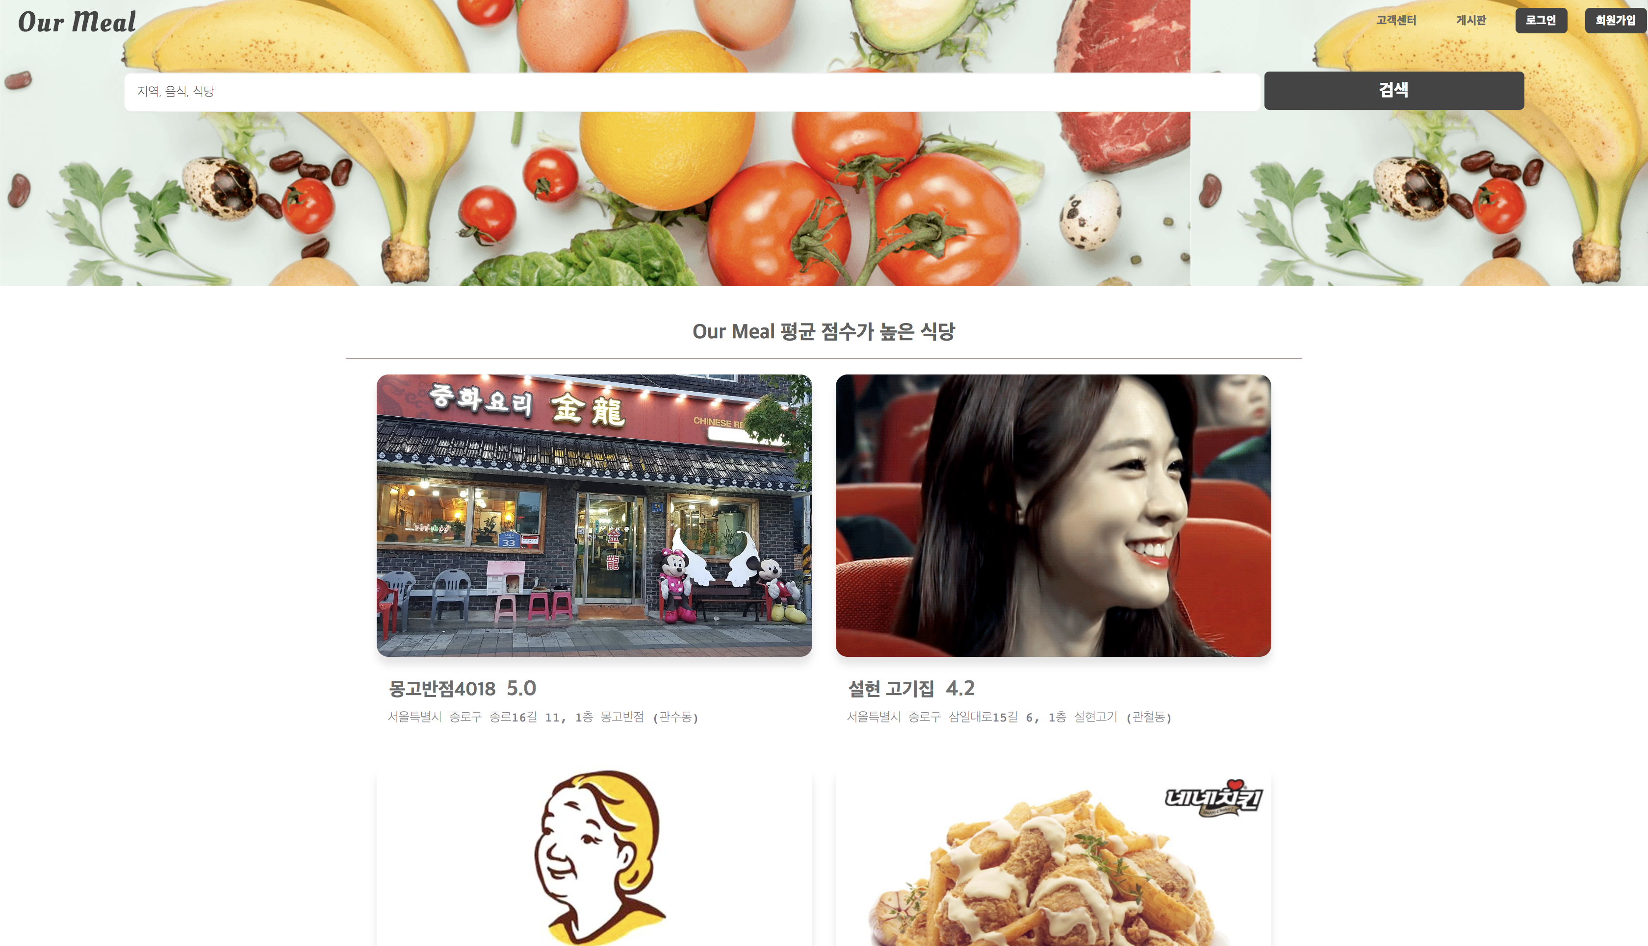
Function(Main)
Web&App Project
Our Meal
By Java King
- 카테고리(평점, 리뷰, 날짜, 추천) 가게 썸네일

Slide 17
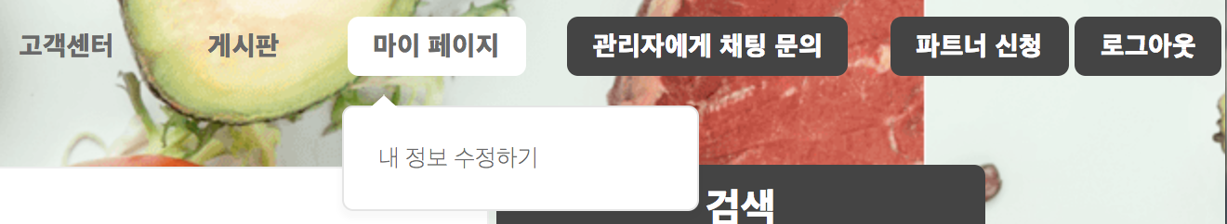
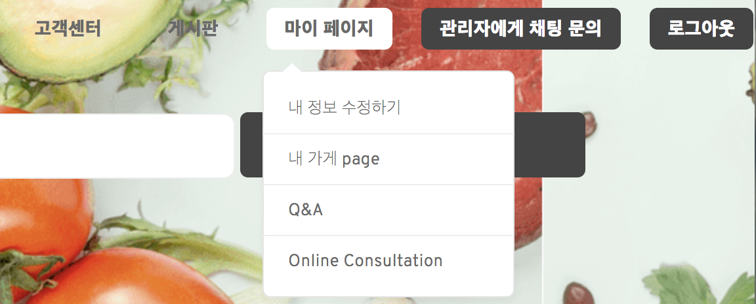
Function(Main)
Web&App Project
Our Meal
By Java King
<Member>
<Partner>
Member 타입을 기준으로 JSTL을 사용하여
버튼 활성화/비활성화

Slide 18
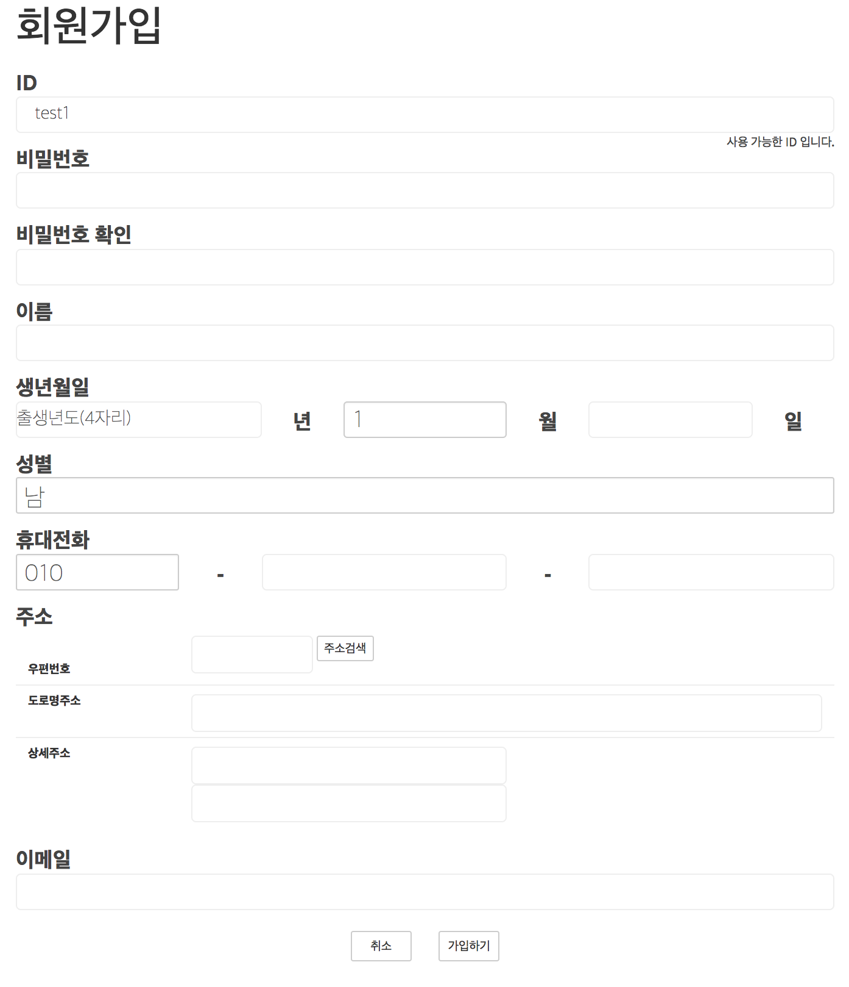
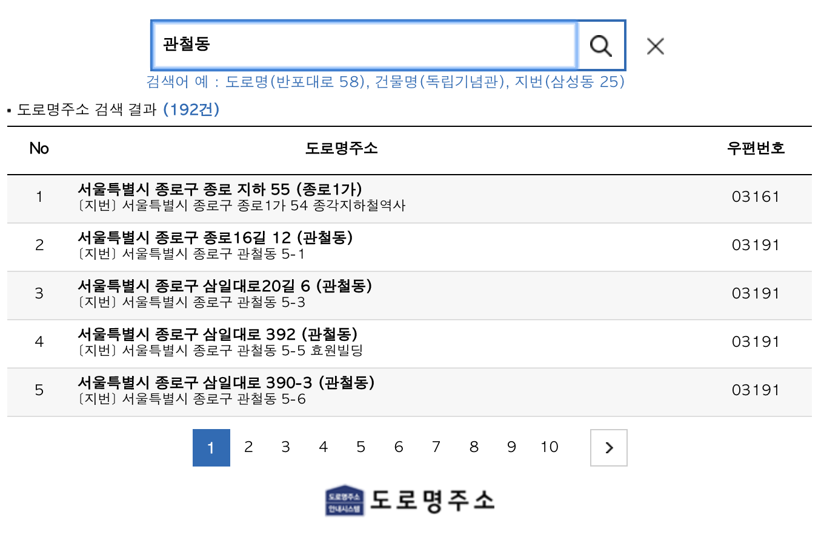
Function(Join)
Web&App Project
Our Meal
By Java King
비동기 통신을 통한 ERROR 검사
도로명주소API를 사용

Slide 19
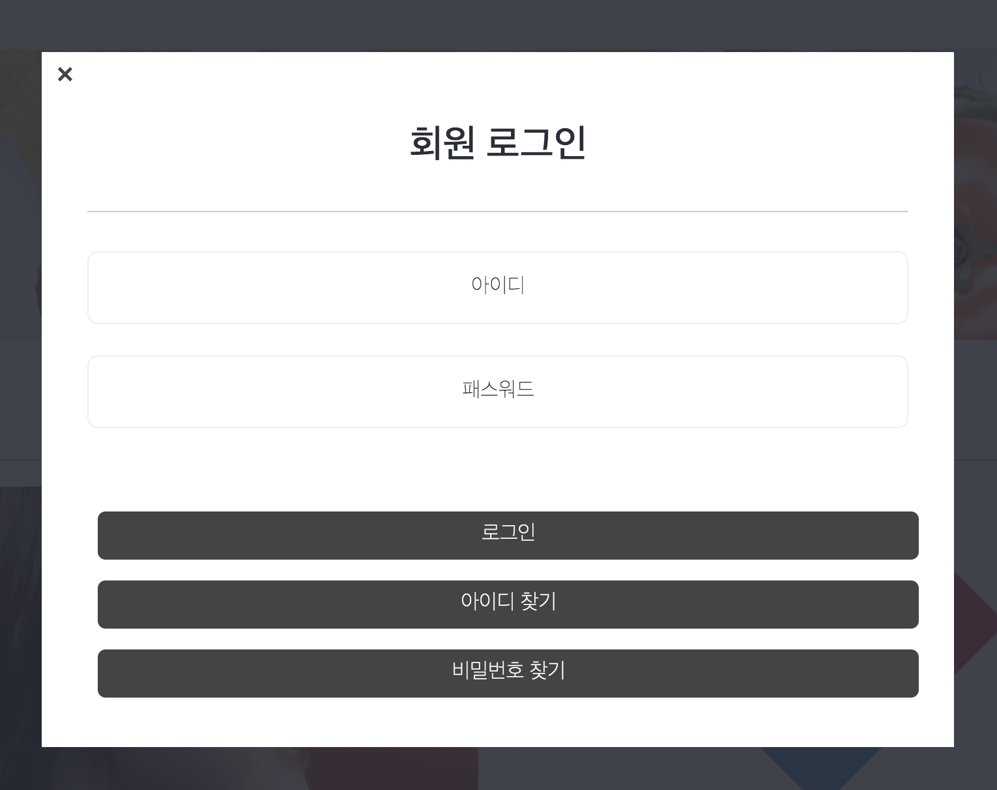
Function(Login)
Web&App Project
Our Meal
By Java King
비동기 통신을 통한 로그인 처리
동적 HTML처리

Slide 20
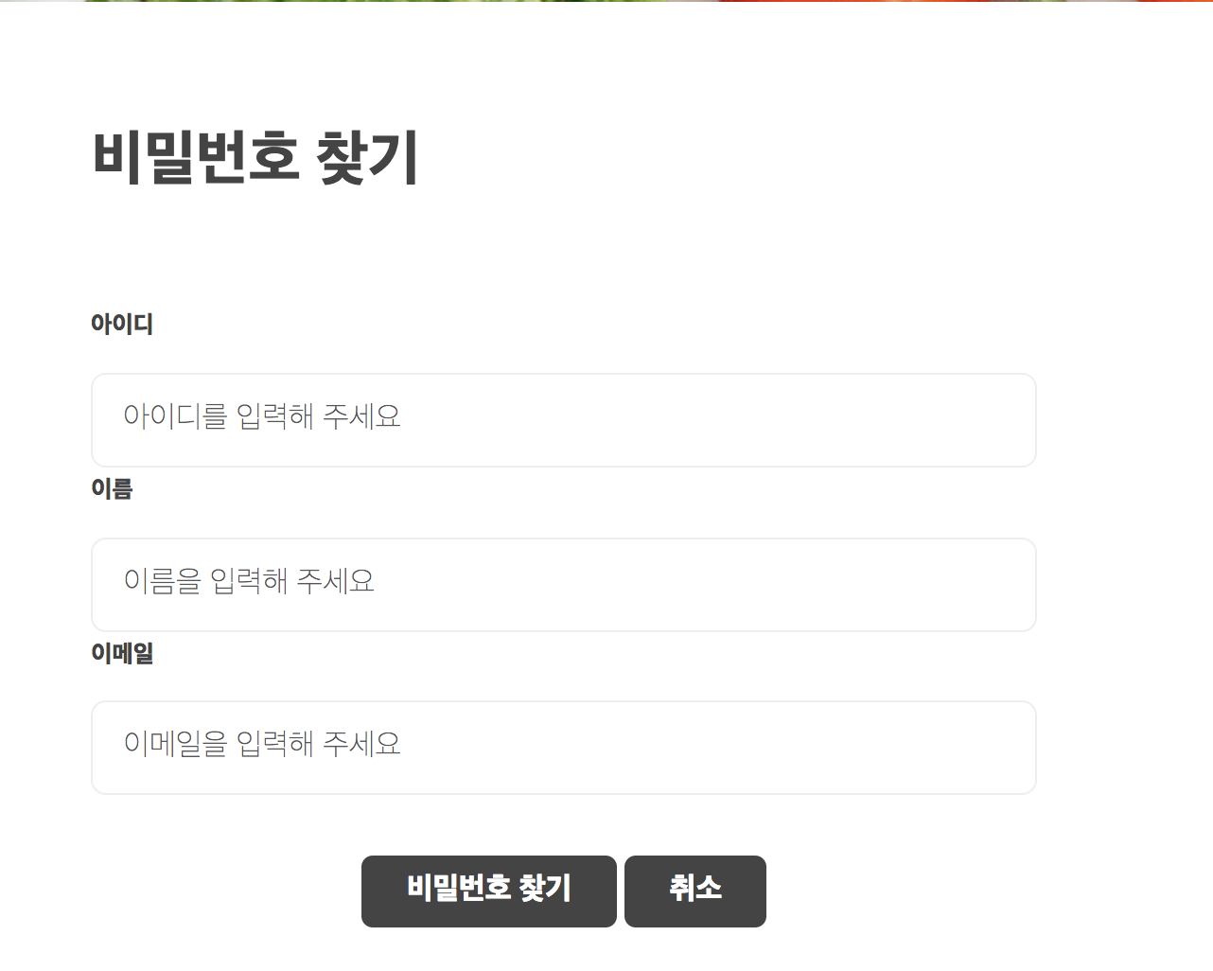
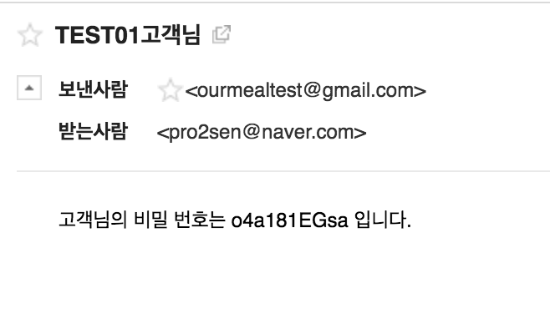
Function(Login)
Web&App Project
Our Meal
By Java King
MimeMessage를 사용한 비밀번호 찾기

Slide 21
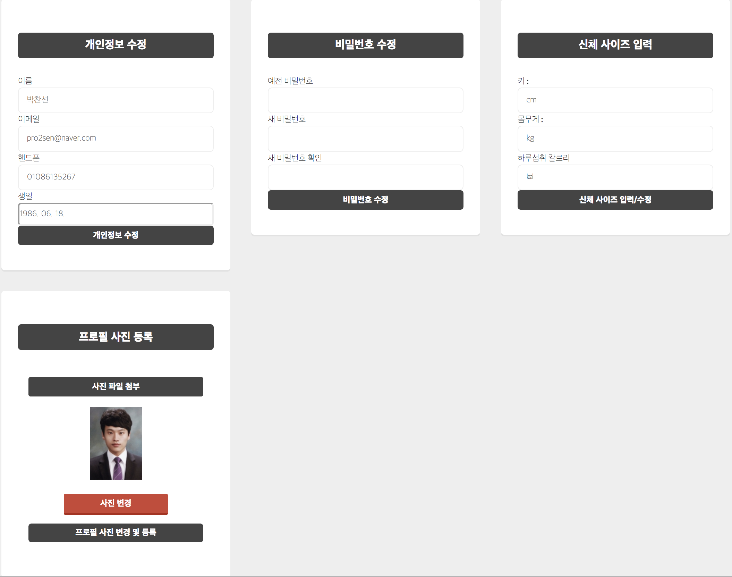
Function(My Page)
Web&App Project
Our Meal
By Java King

Slide 22
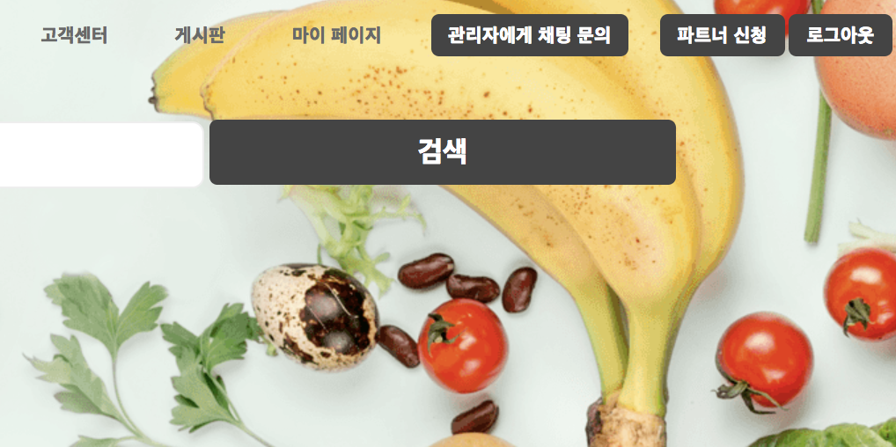
Function(Chatting)
Web&App Project
Our Meal
By Java King

Slide 23
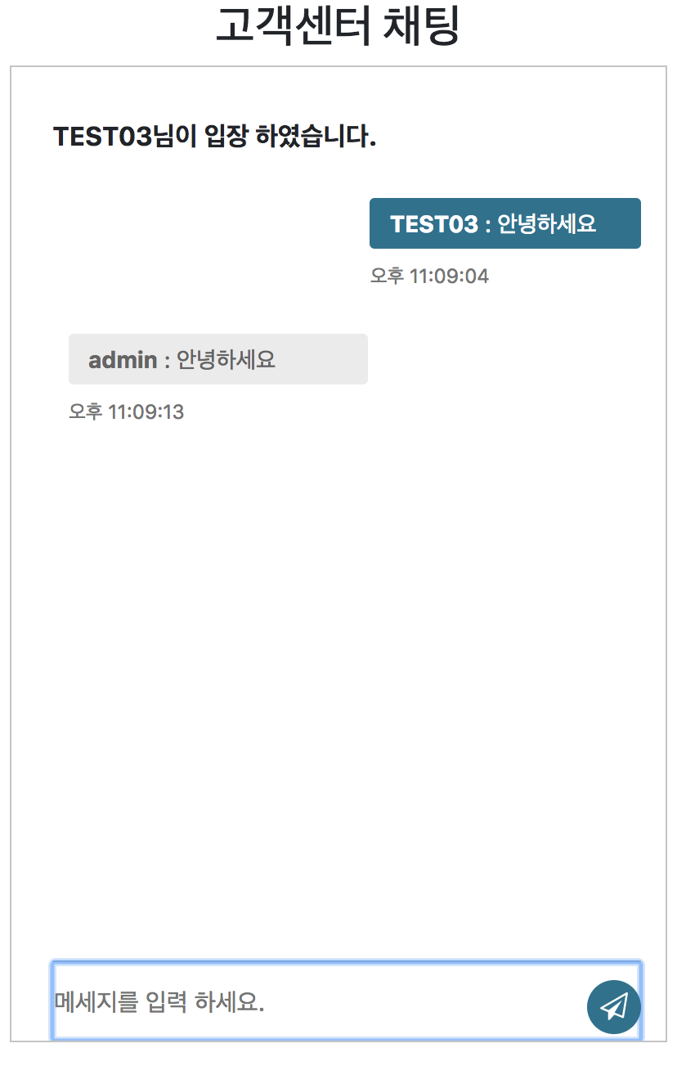
- Node.js를 기반으로한 Sockjs 를 사용하여 구현

Slide 24
Function(Partner)
Web&App Project
Our Meal
By Java King

Slide 25
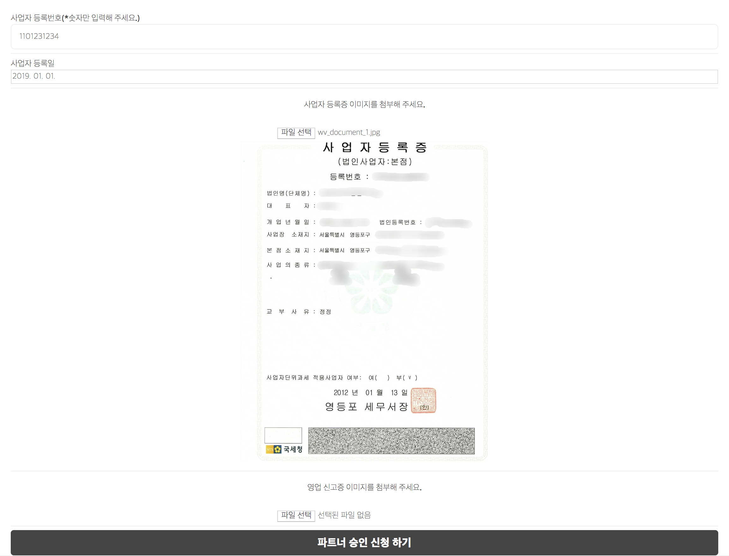
Function(Partner)
Web&App Project
Our Meal
By Java King
- Partner 신청 → 관리자 승인 → Partner 등록

Slide 26
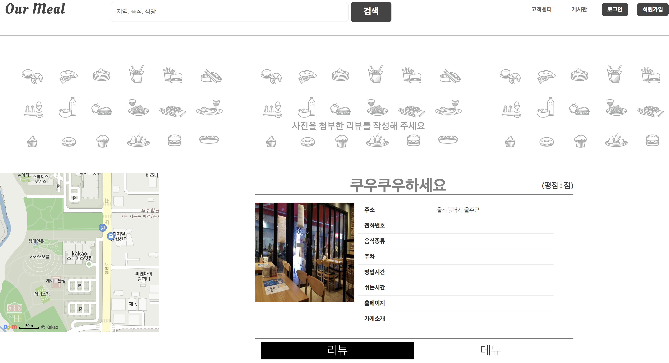
Function(Store Page)
Web&App Project
Our Meal
By Java King
- 기본 StorePage

Slide 27
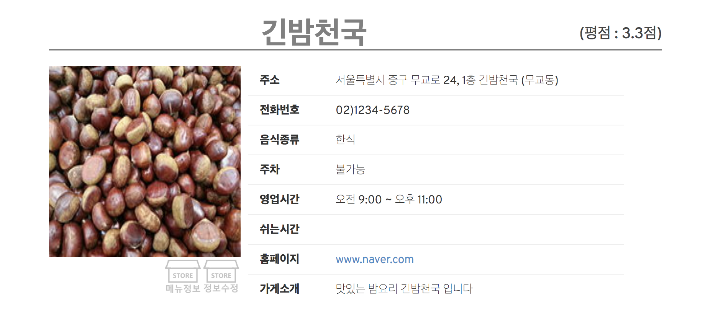
Function(Store Page)
Web&App Project
Our Meal
By Java King
DB의 Store Table 에 참조 되어있는 접속자 ID를 기준으로 버튼 활성화/비활성화

Slide 28
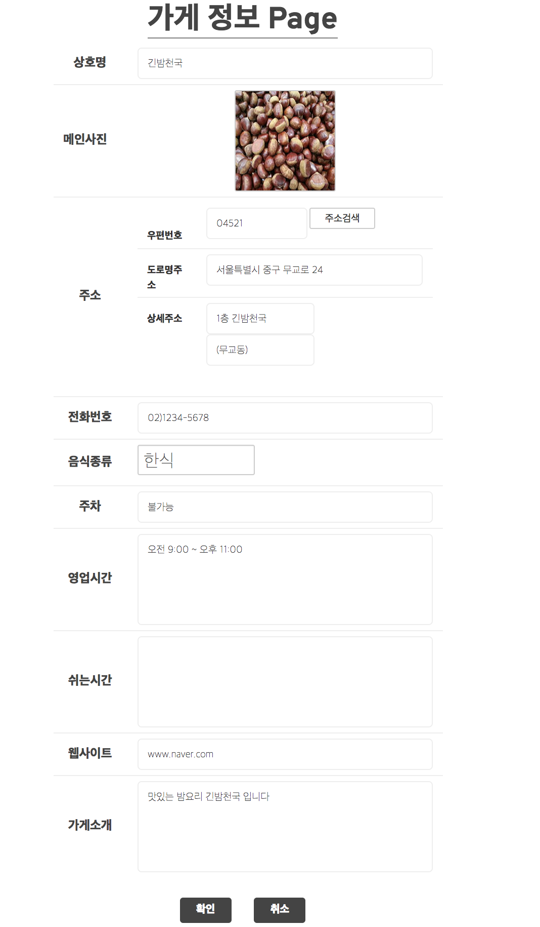

Slide 29
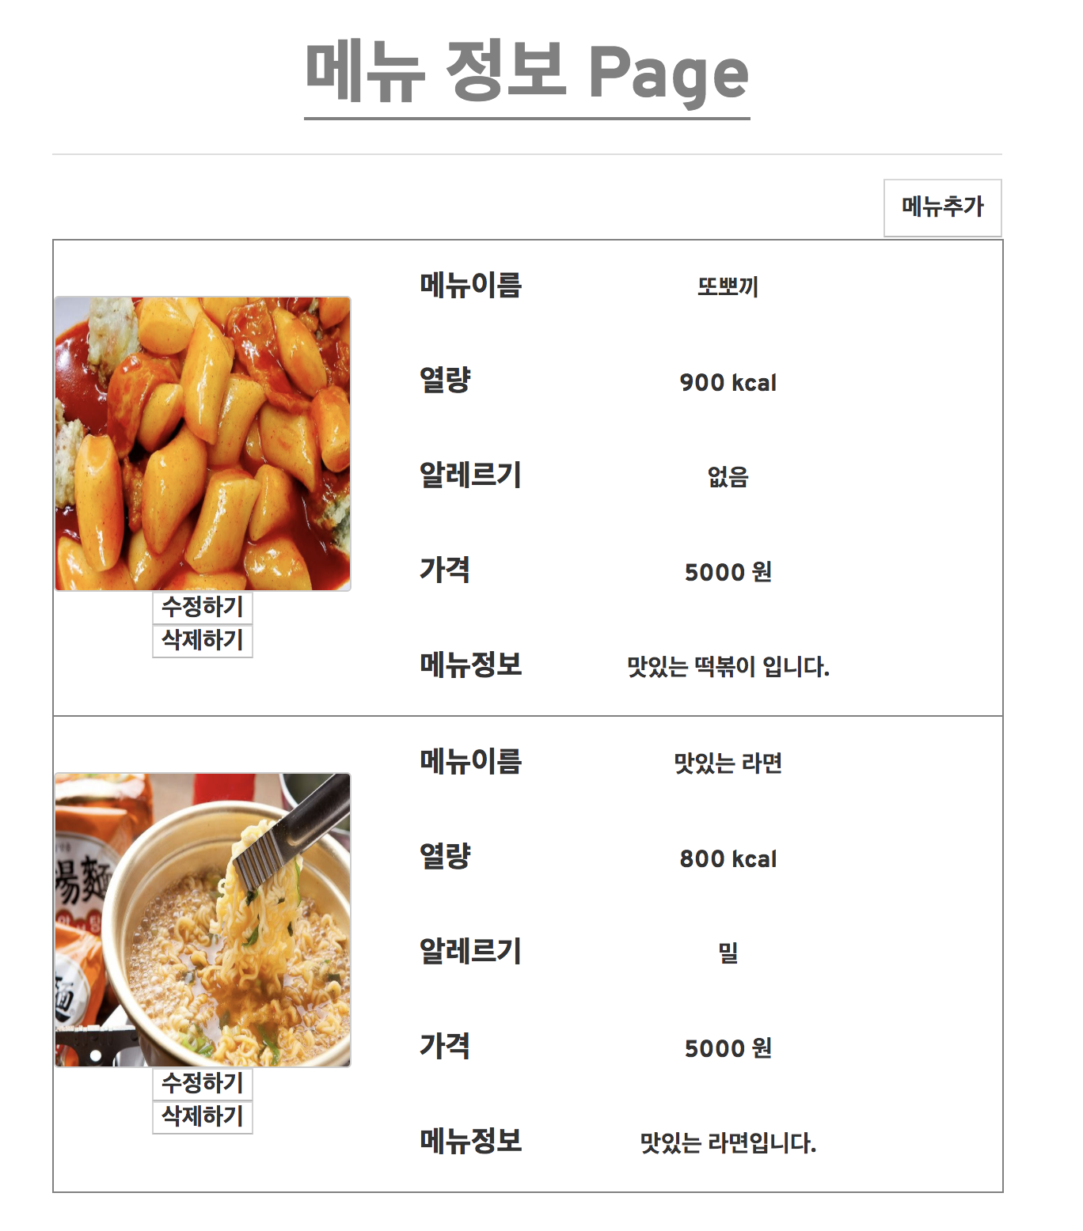
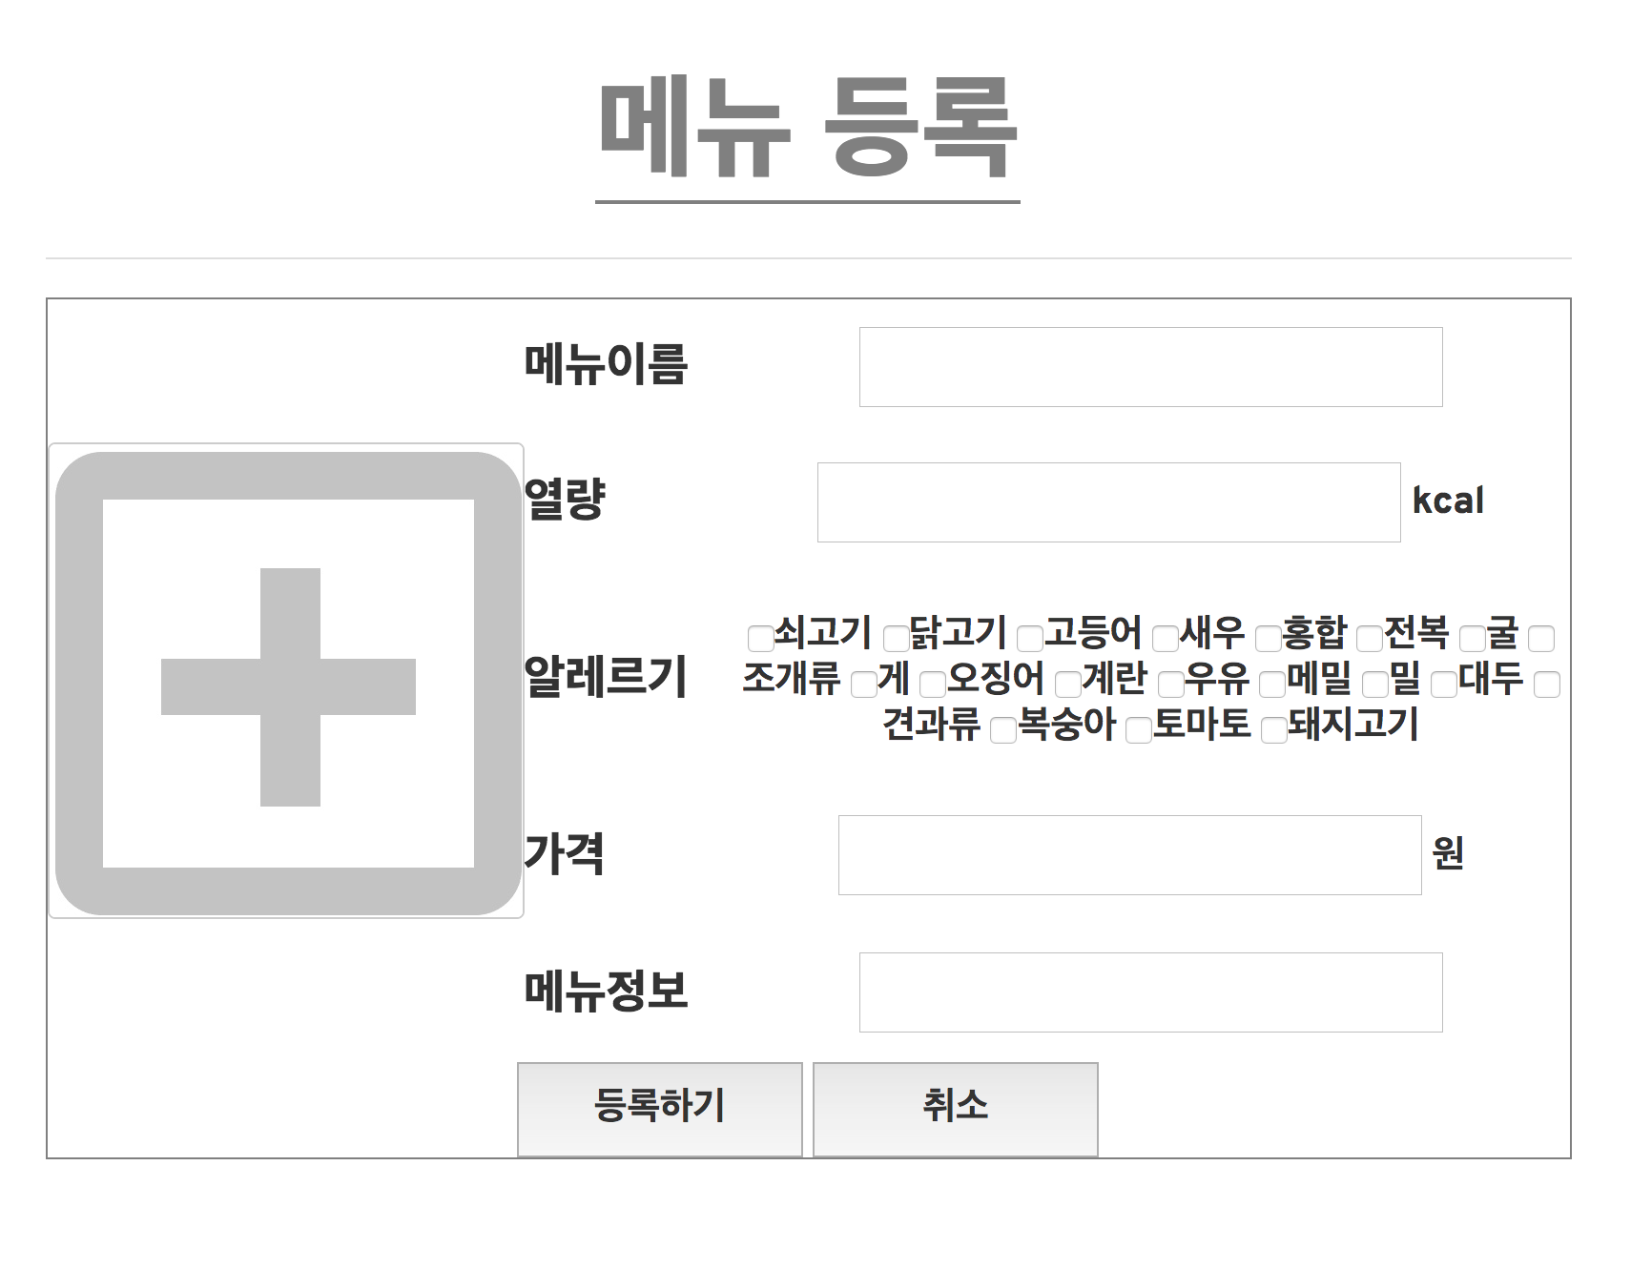
Function(Store Page)
Web&App Project
Our Meal
By Java King

Slide 30
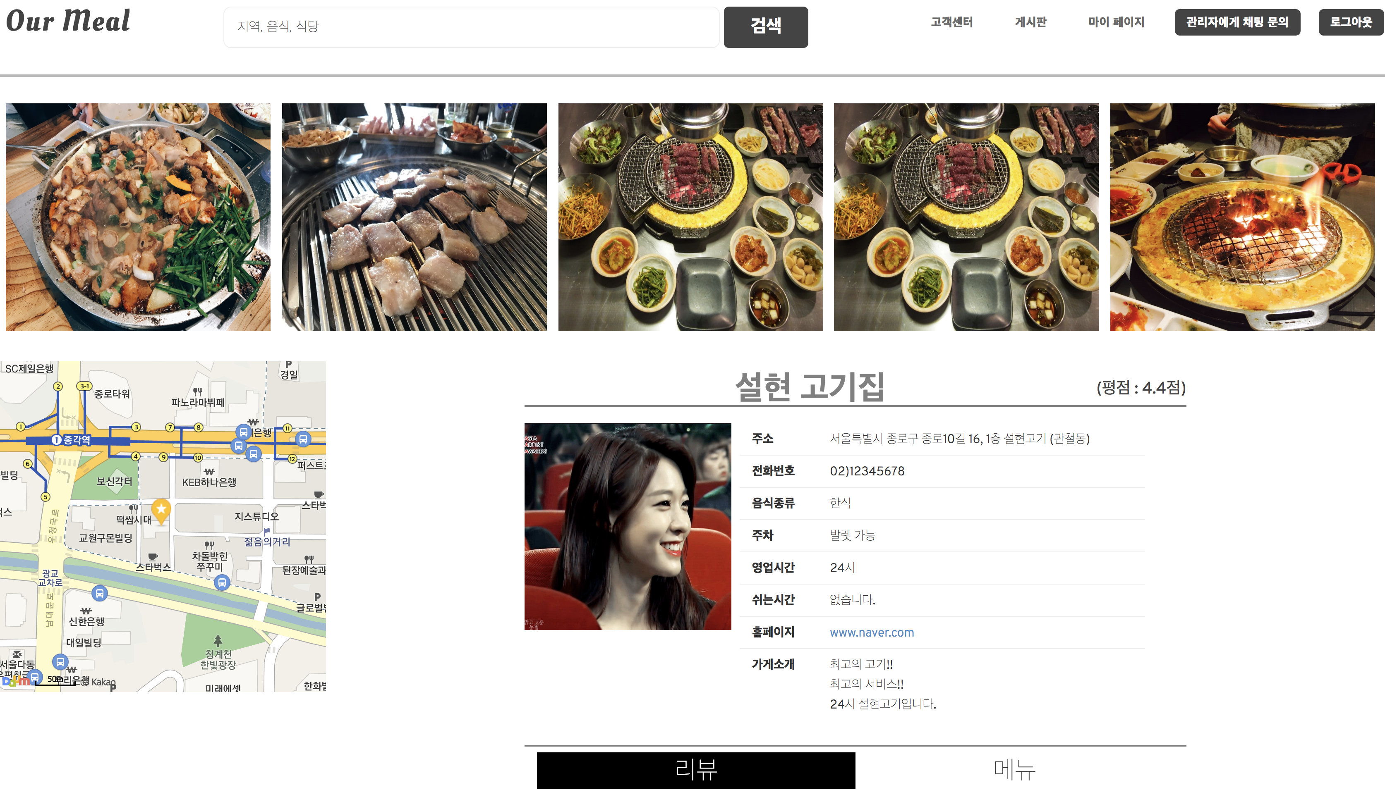
Function(Store Page)
Web&App Project
Our Meal
By Java King
- kakao map API를 사용하여 주소의 좌표를 지도에 표시

Slide 31
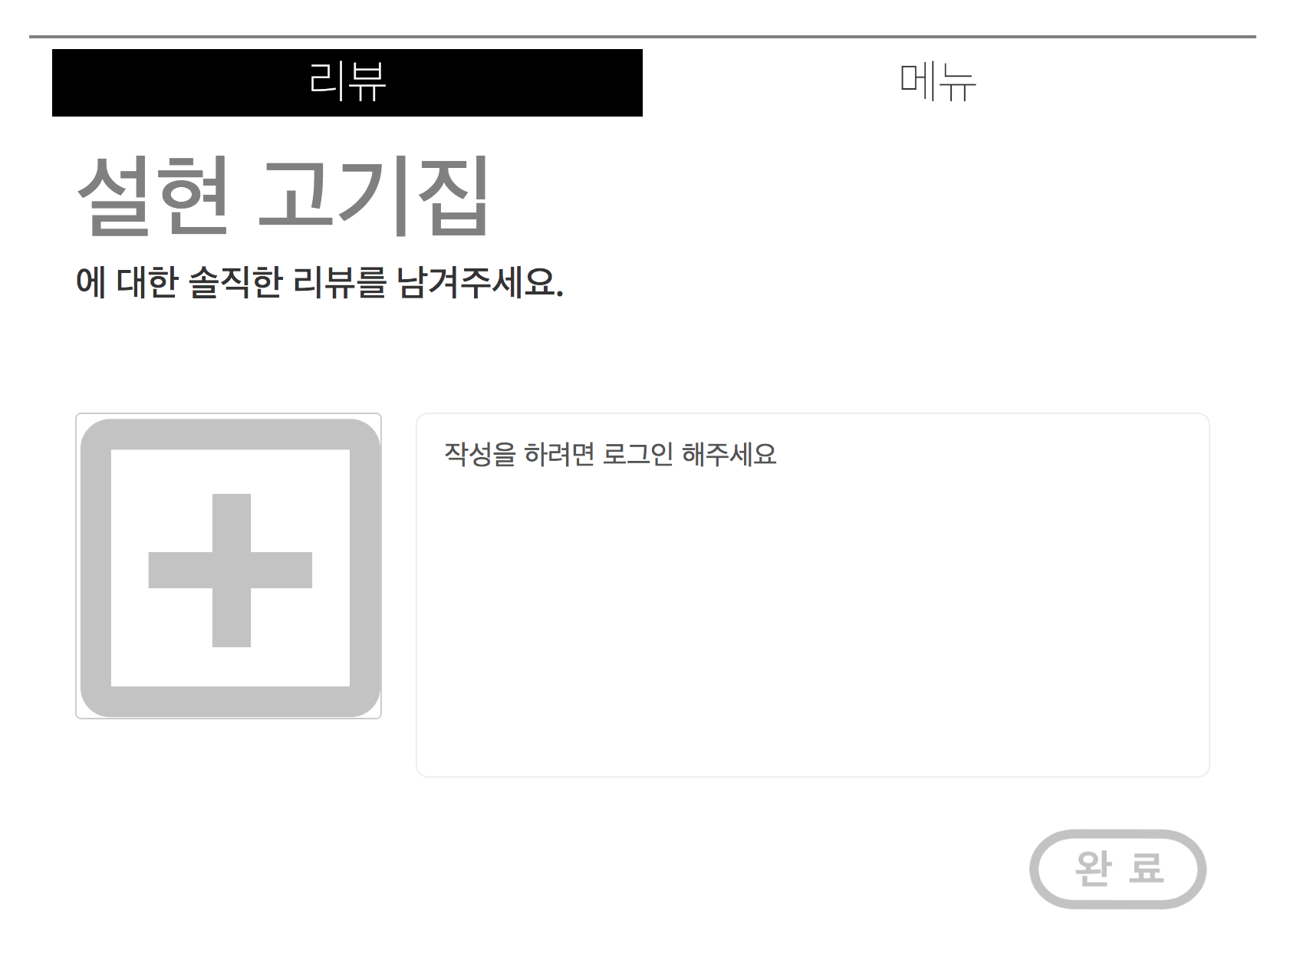
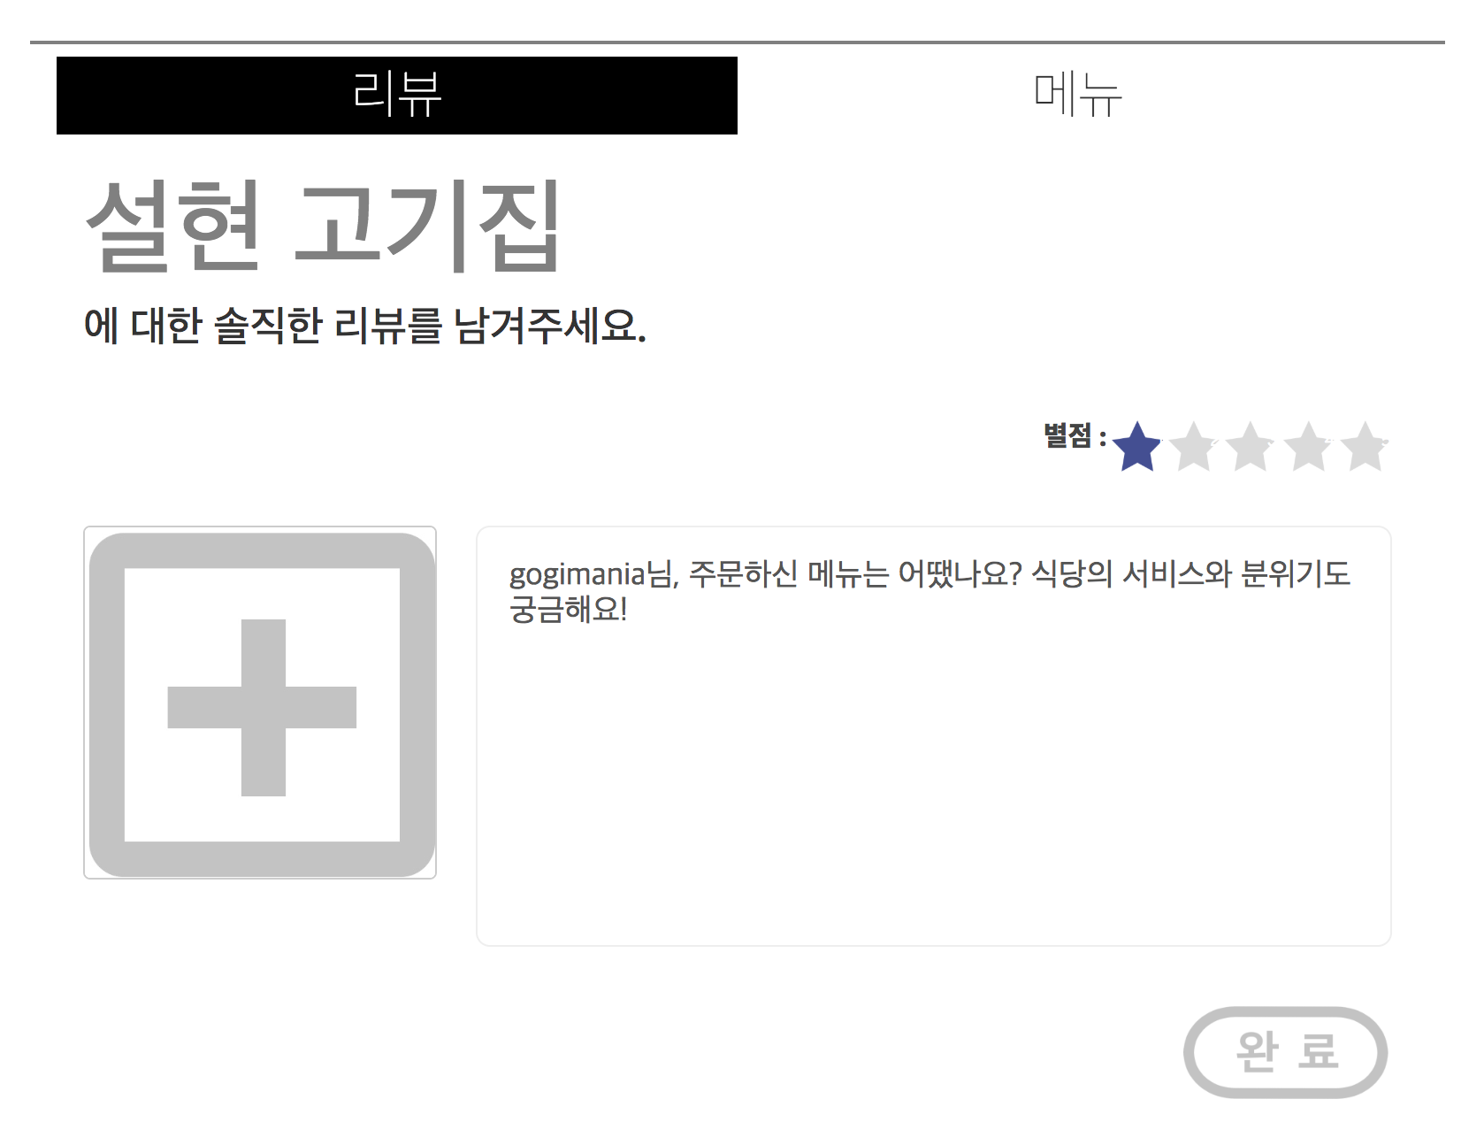
Function(Store Page)
Web&App Project
Our Meal
By Java King
- 로그인 여부를 확인하여 작성 창 활성화/비활성화

Slide 32
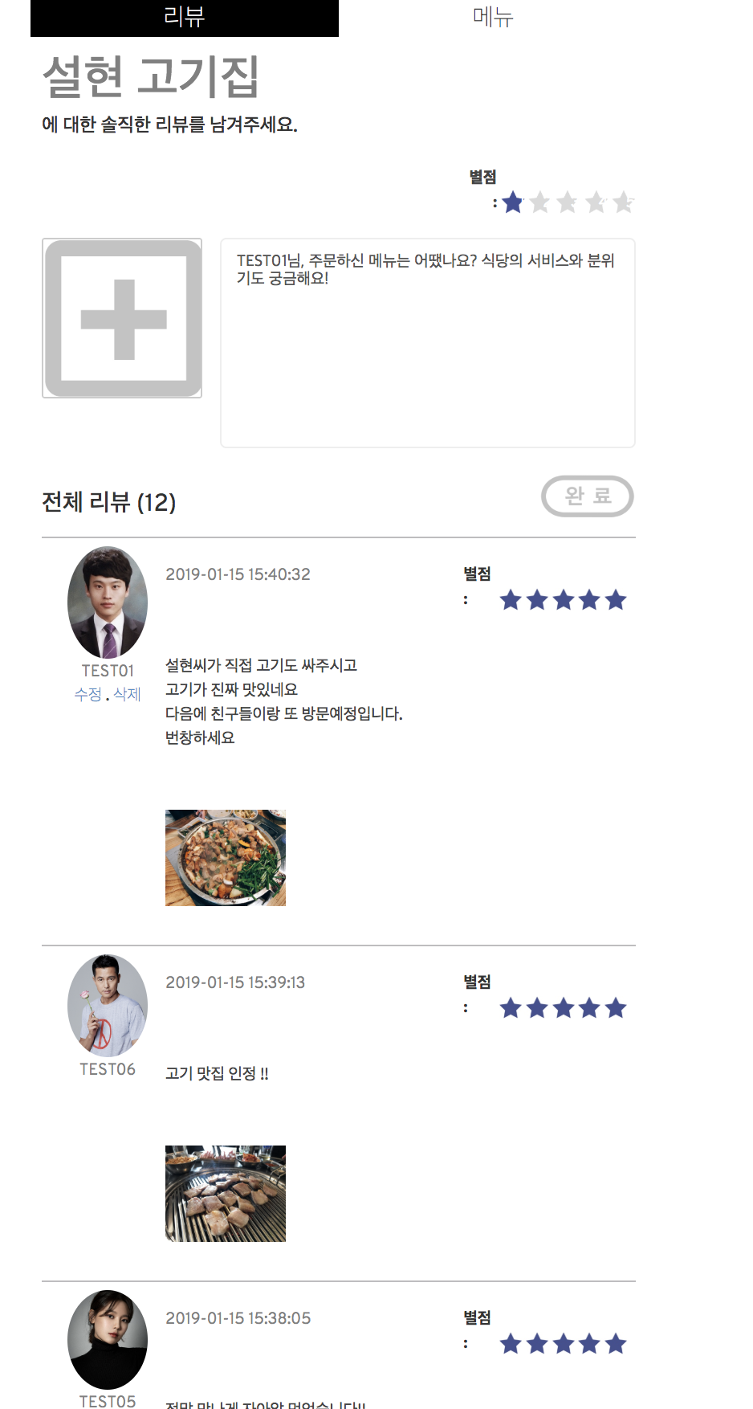
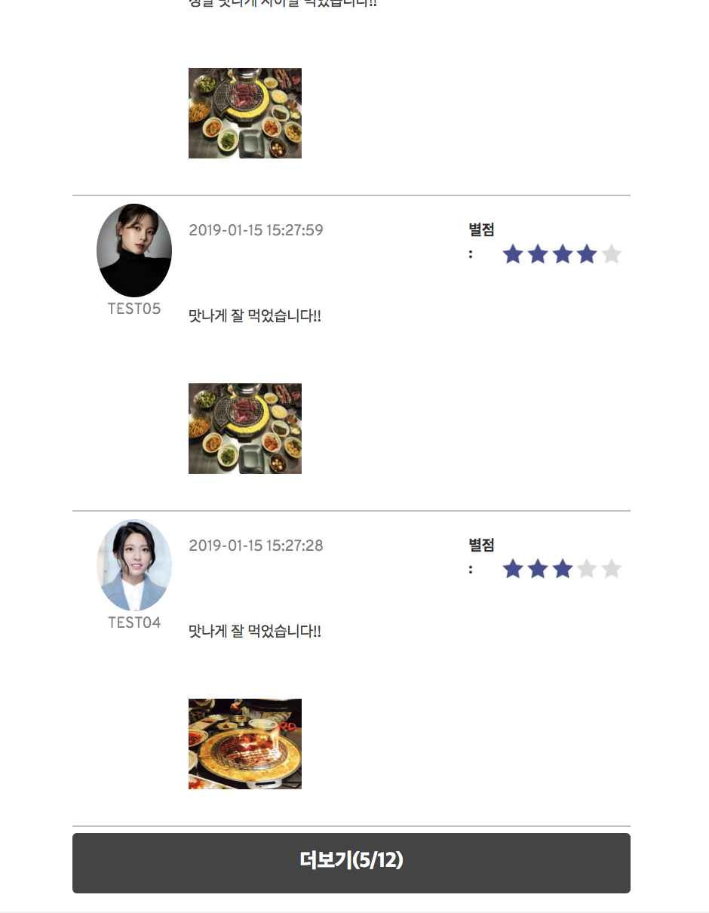
Function(Store Page)
Web&App Project
Our Meal
By Java King
- 비동기 통신을 통한 더보기 버튼 구현

Slide 33
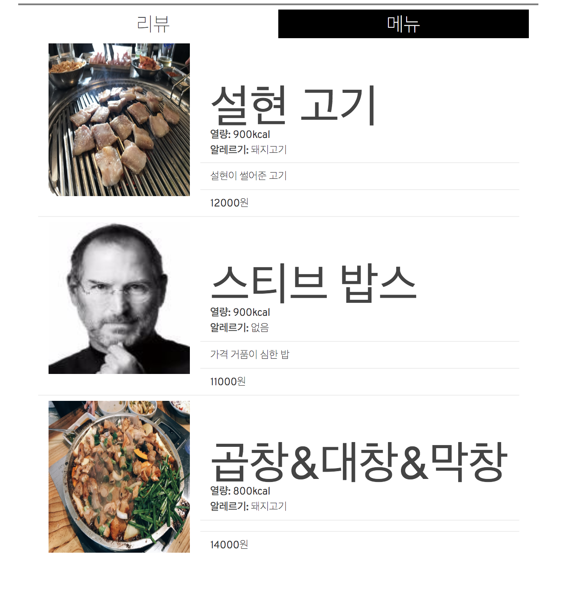
Function(Store Page)
Web&App Project
Our Meal
By Java King

Slide 34
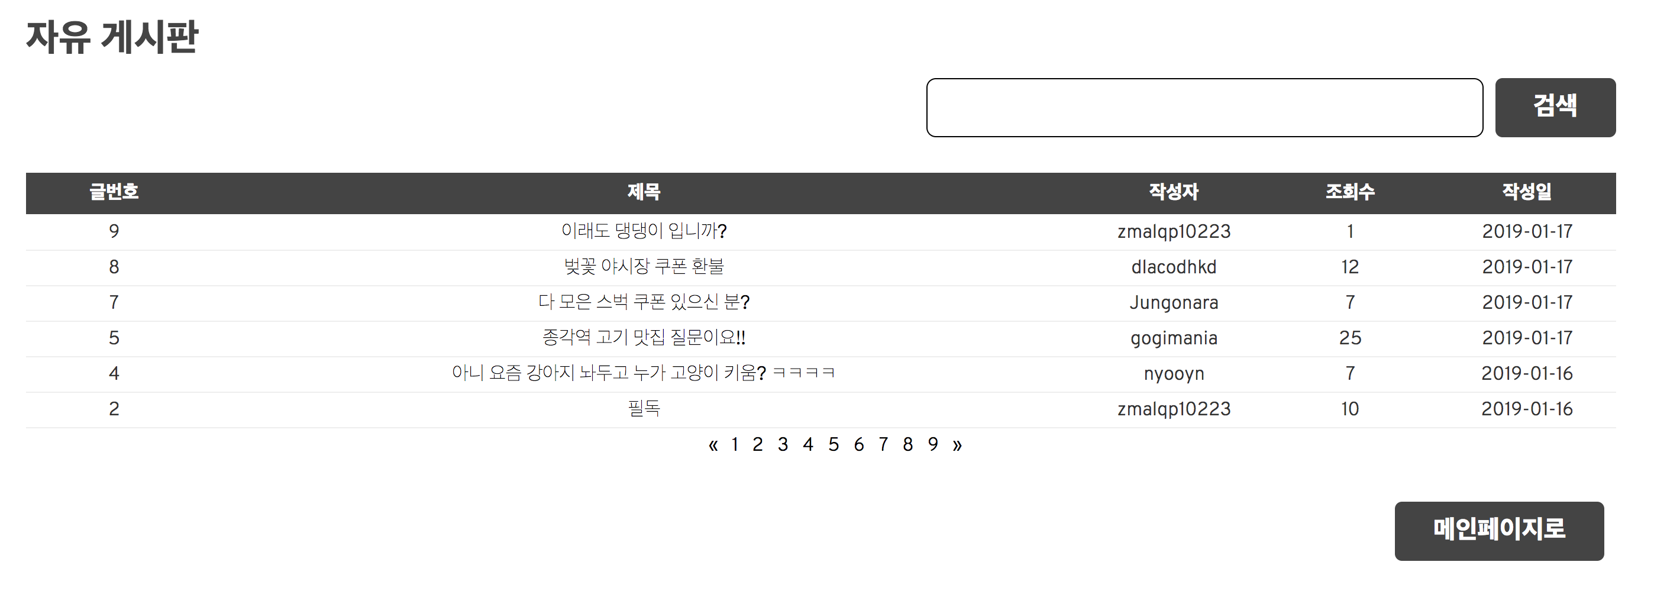
Function(Board)
Web&App Project
Our Meal
By Java King

Slide 35
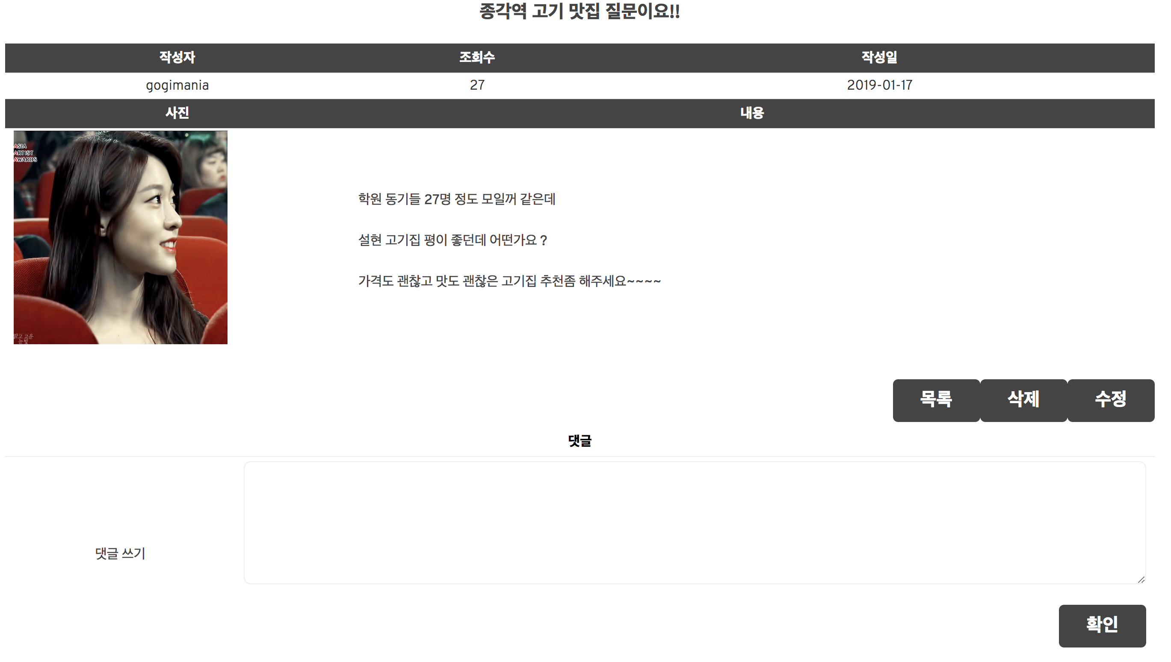
Function(Board)
Web&App Project
Our Meal
By Java King

Slide 36
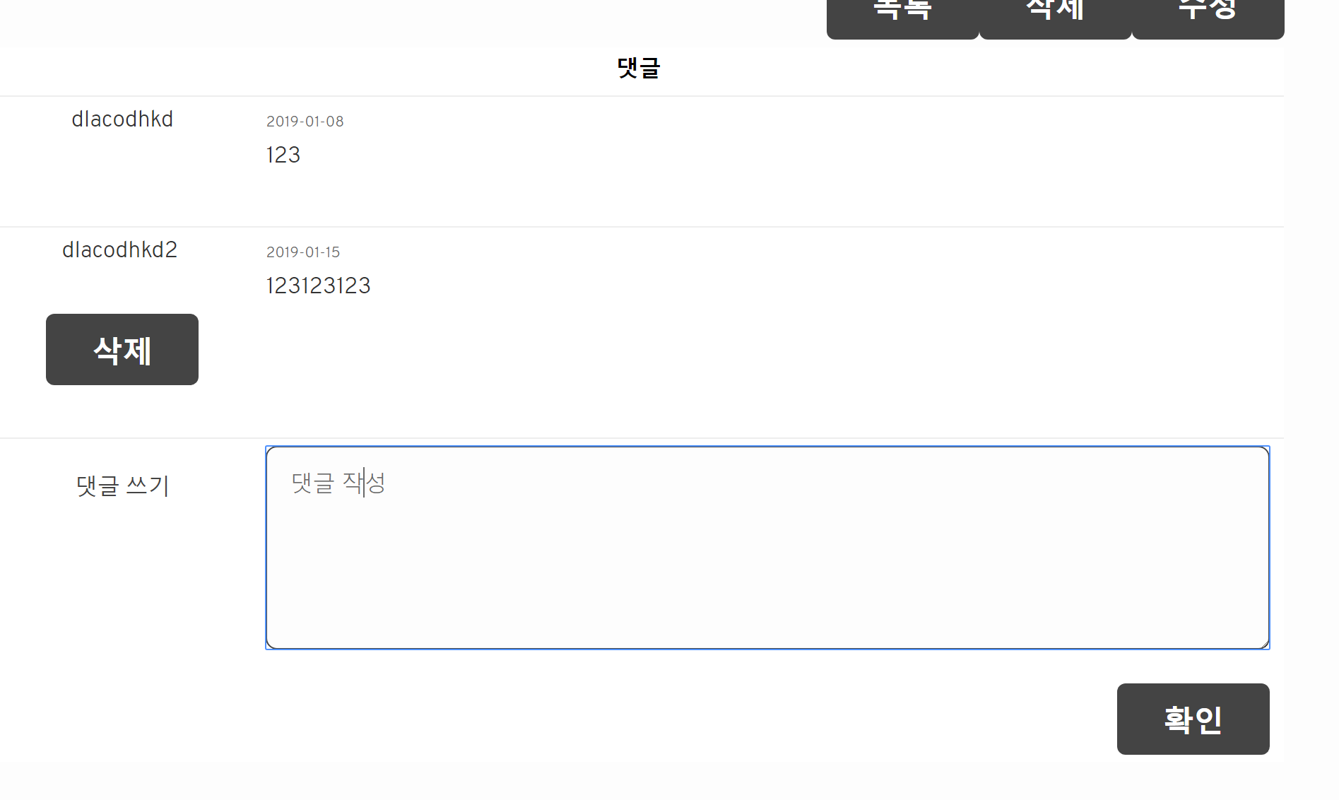
Function(Board)
Web&App Project
Our Meal
By Java King

Slide 37
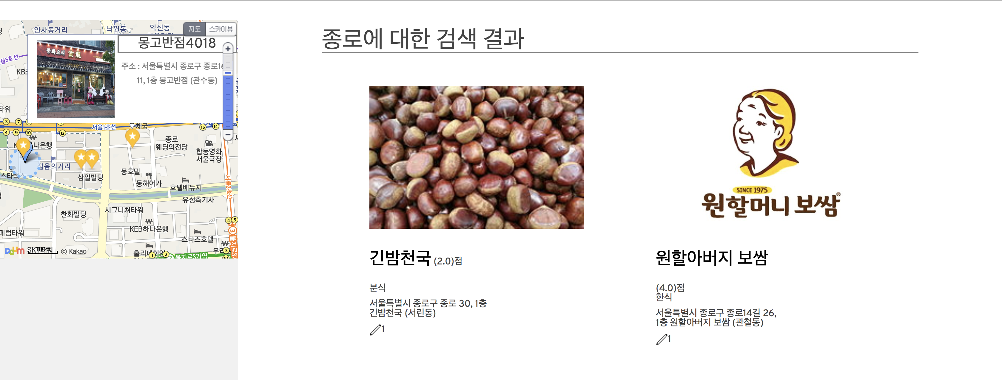
Function(Search)
Web&App Project
Our Meal
By Java King
kakao map API를 사용하여 사용자를 중심으로
주변의 검색 결과들을 마커로 표시

Slide 38


App Project
Web&App Project
Our Meal
By Java King
기존의 Web Project를 확장하여 App 개발
같은 Web Server를 사용하고 RestController를 사용하여 구현

Slide 39

ANDROID
Web&App Project
Our Meal
By Java King

Slide 40
ANDROID
Structure Map
Web&App Project
Our Meal
By Java King
Our Meal
Search
Main page
Store
Image Upload
Join Membership
My Page
Review

Slide 41
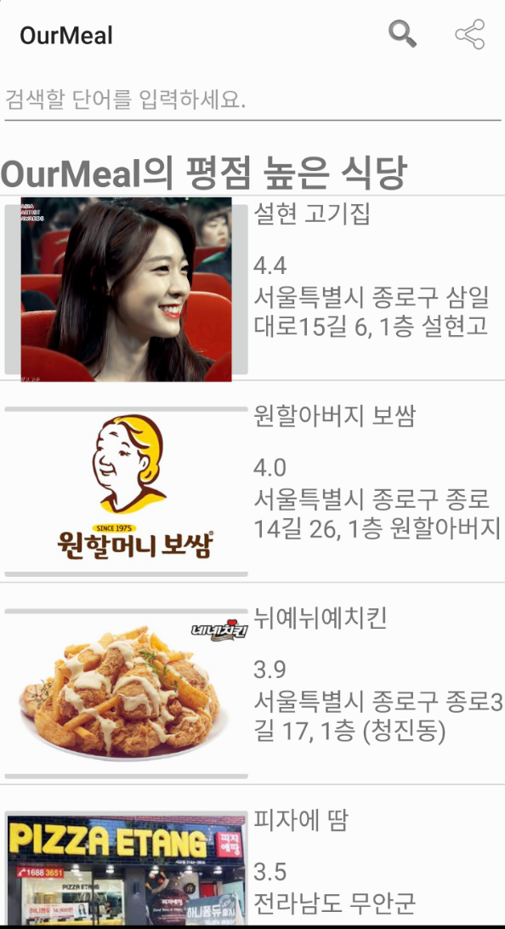
ANDROID (Main)
Web&App Project
Our Meal
By Java King
Web 메인 화면에서 보여주는 정보를 동적으로 구현

Slide 42
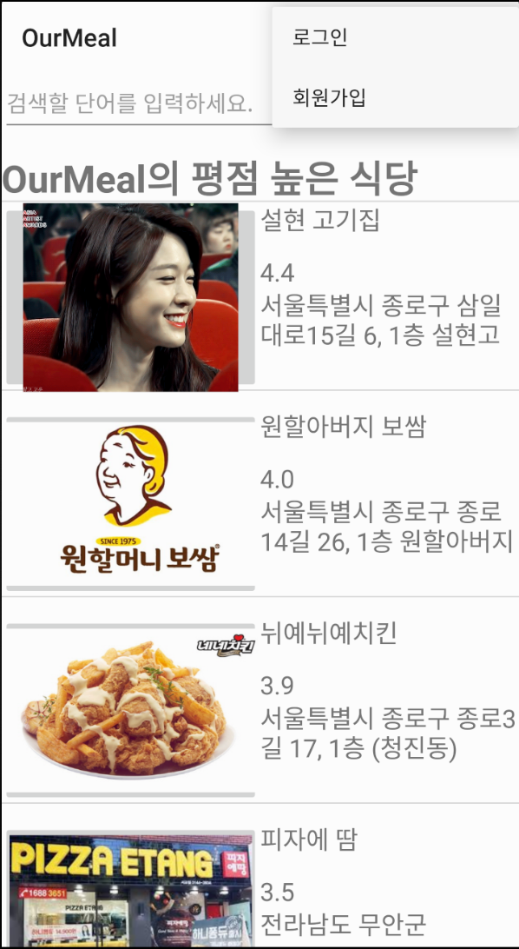
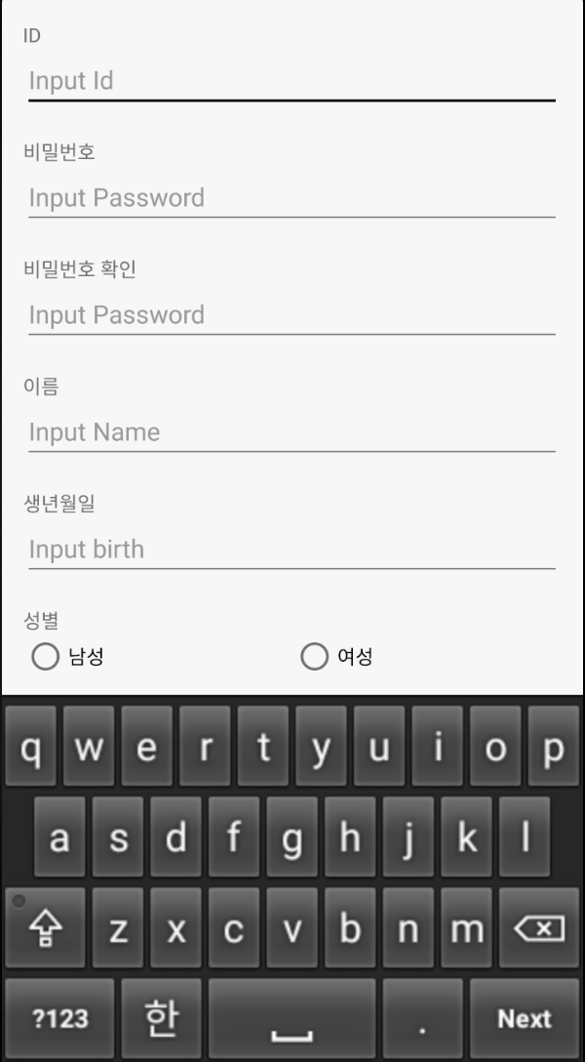
ANDROID (Join)
Web&App Project
Our Meal
By Java King

Slide 43
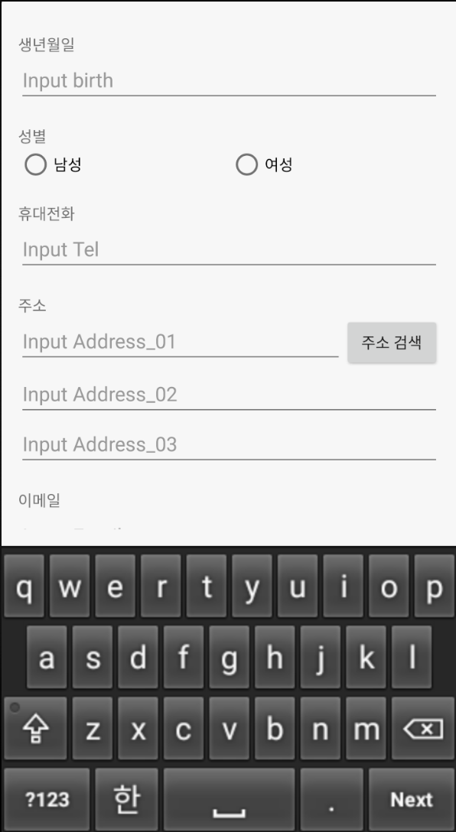
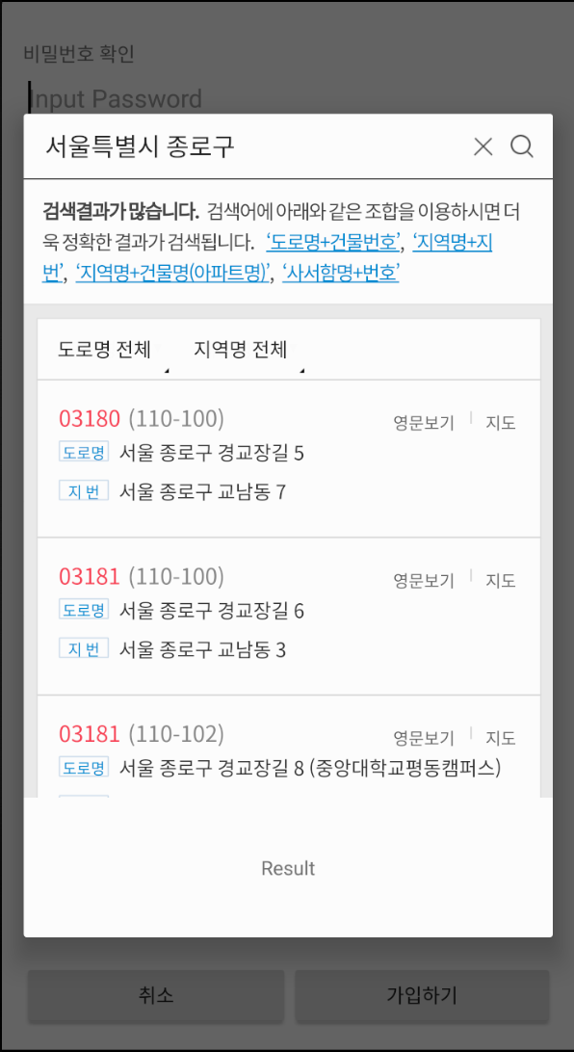
ANDROID (Join)
Web&App Project
Our Meal
By Java King
Kakao우편번호
API를 사용하여
Dialog로WebView
주소검색 구현

Slide 44
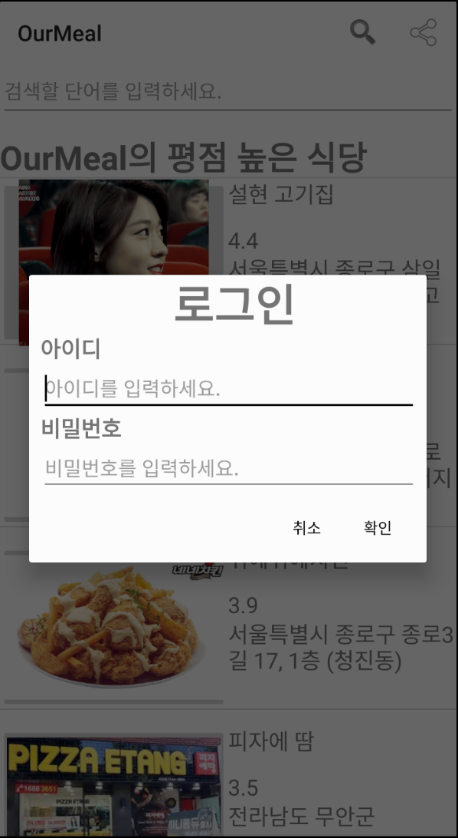
ANDROID (Login)
Web&App Project
Our Meal
By Java King
Login 성공시
CookieManager 를
사용하여 URL과
Member ID를 저장하여 Session유지

Slide 45
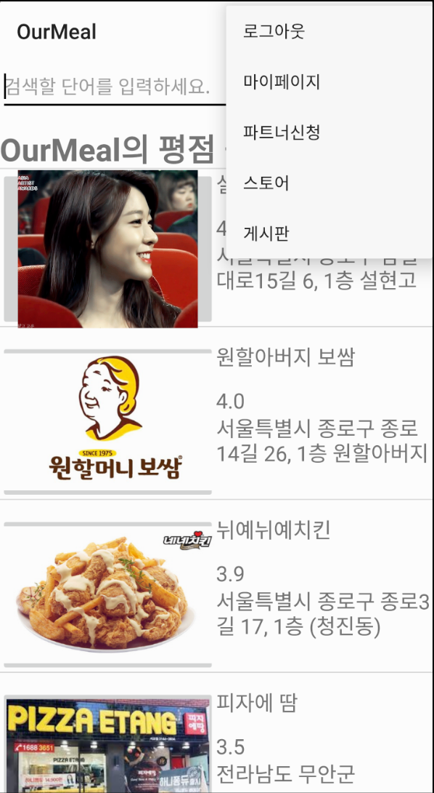
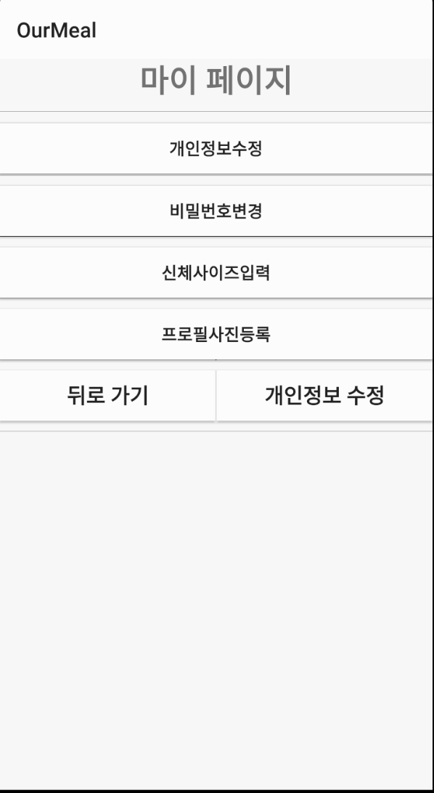
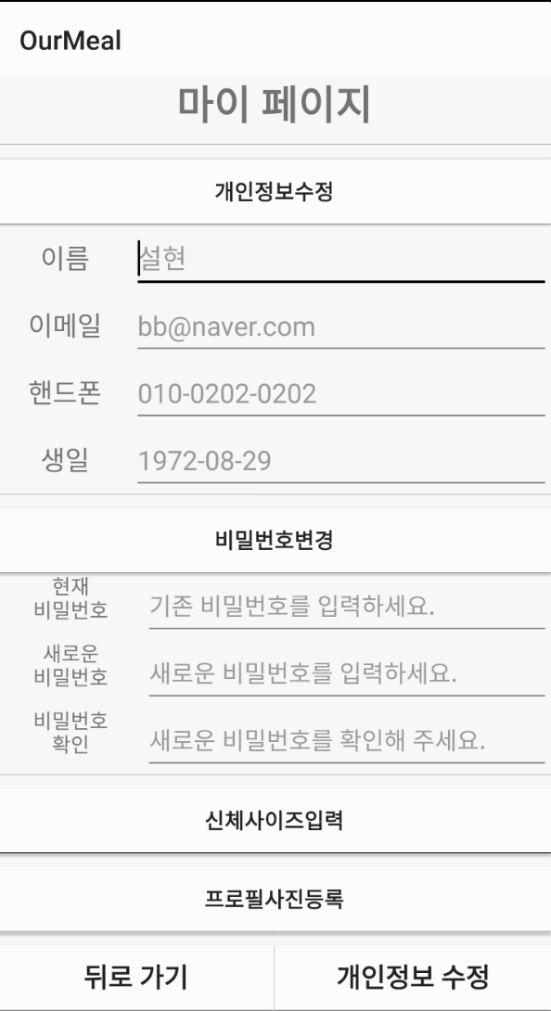
ANDROID (My Page)
Web&App Project
Our Meal
By Java King

Slide 46
ANDROID (Main)
Web&App Project
Our Meal
By Java King
Store 정보의 사진을 터치하면
해당 Store Page로 이동

Slide 47
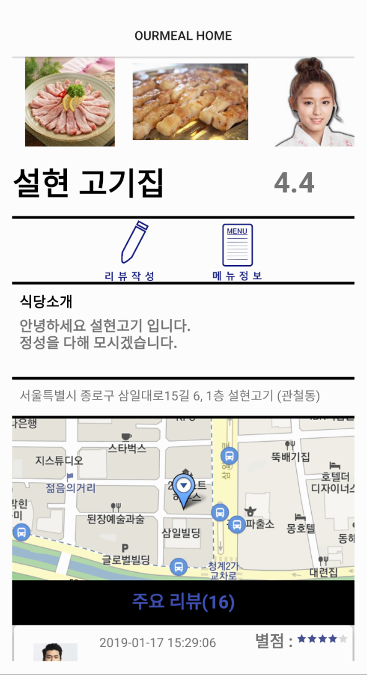
ANDROID (Store Page)
Web&App Project
Our Meal
By Java King
(1)
(1) 사용자들이 남긴 리뷰의 이미지를 HorizontalScrollView를 사용하여 구현
(2) kakaomap API를 사용하여
DB에 저장되어 있는 가게의 주소를
WebView로 구현
(2)

Slide 48
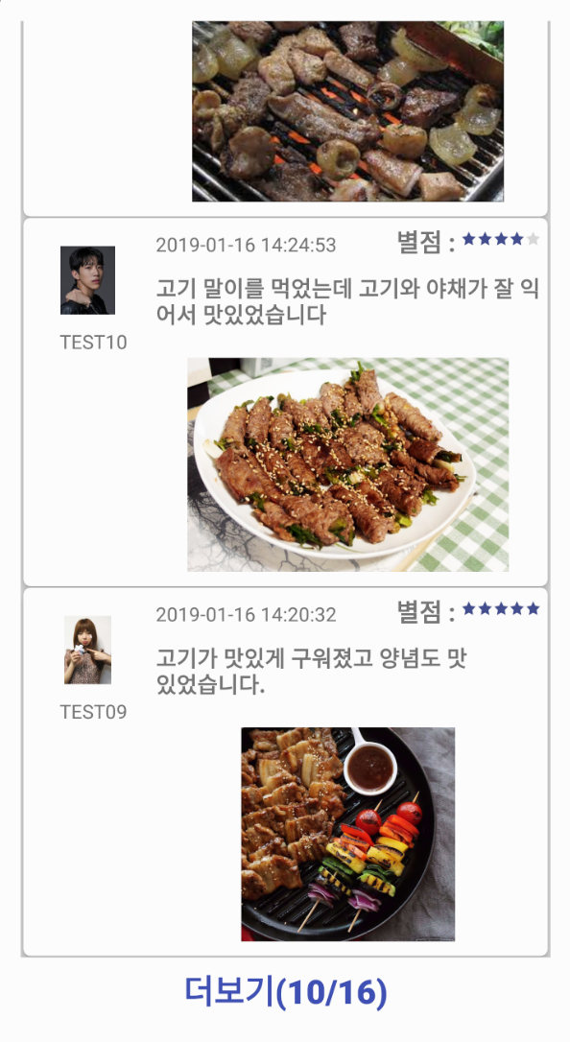
ANDROID (Store Page)
Web&App Project
Our Meal
By Java King
RecyclerView 와 CardView를 사용하여 리뷰를 5개씩 출력
더보기 버튼 구현

Slide 49
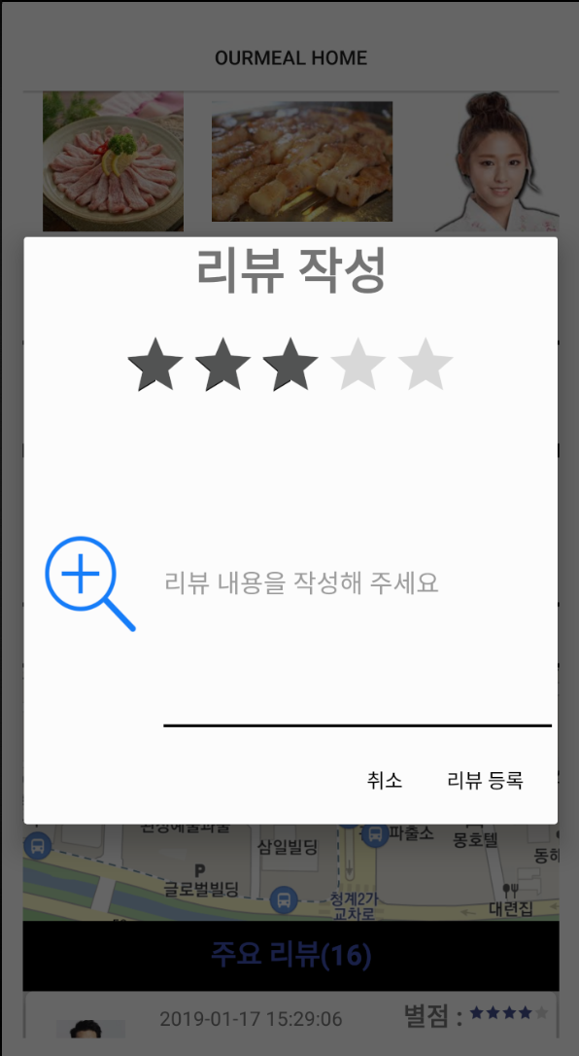
ANDROID (Store Page)
Web&App Project
Our Meal
By Java King

Slide 50
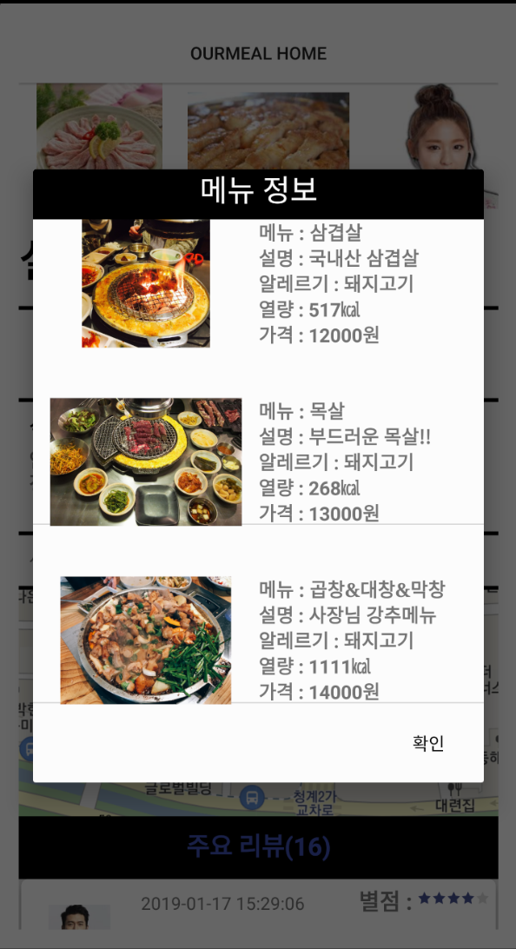
ANDROID (Store Page)
Web&App Project
Our Meal
By Java King

Slide 51
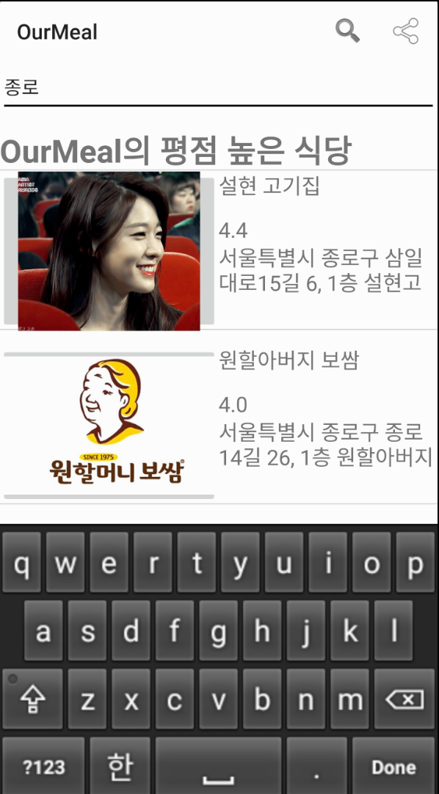
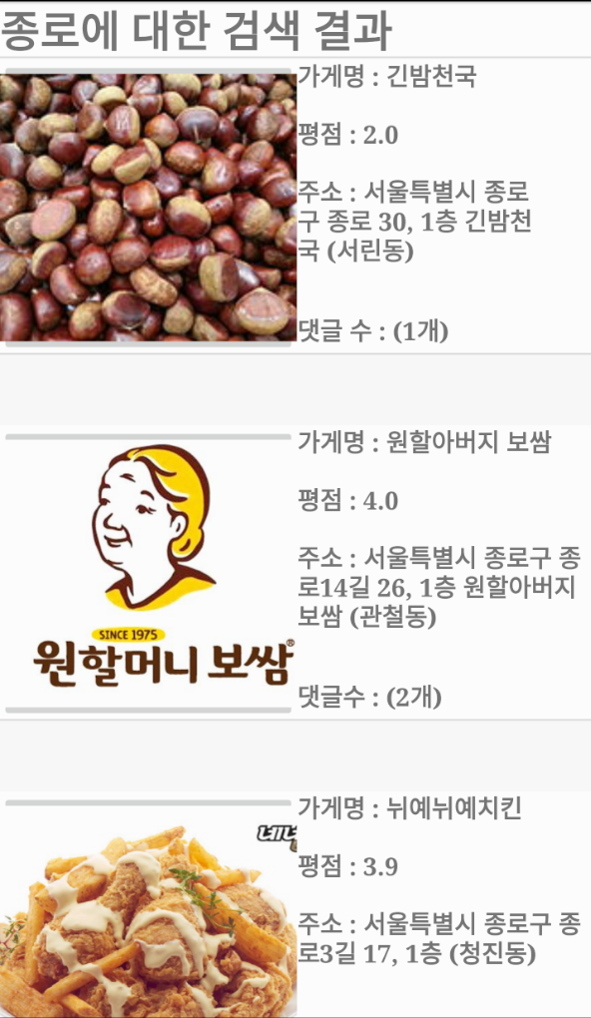
ANDROID (Search)
Web&App Project
Our Meal
By Java King

Slide 52

IOS
Web&App Project
Our Meal
By Java King

Slide 53
IOS
Structure Map
Web&App Project
Our Meal
By Java King
Our Meal
Login
Join Membership
Main page
Store
My Page

Slide 54
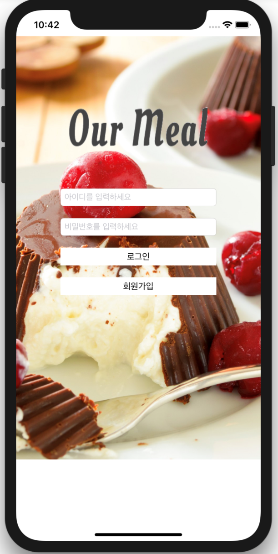
IOS(Login)
Web&App Project
Our Meal
By Java King
짜잔!
Login 성공 시 회원 정보를
UserDefaults에 저장

Slide 55
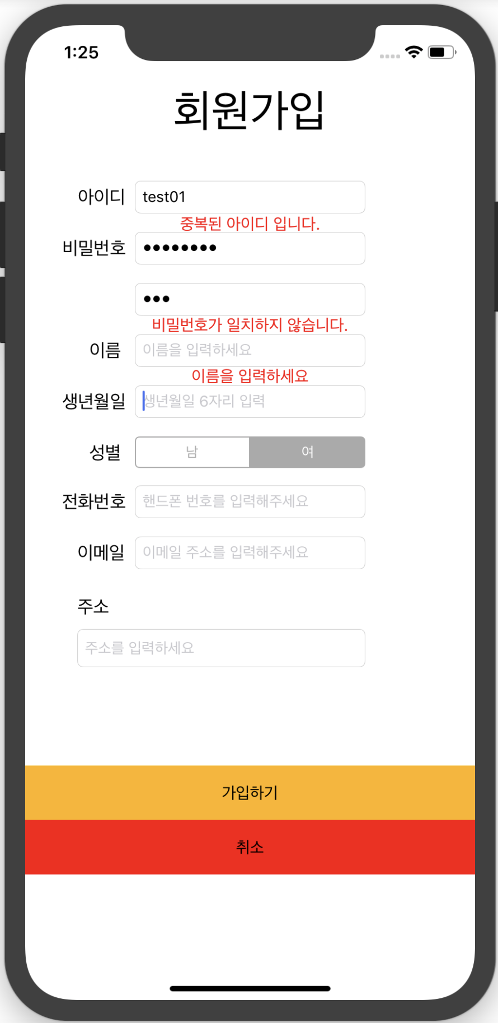
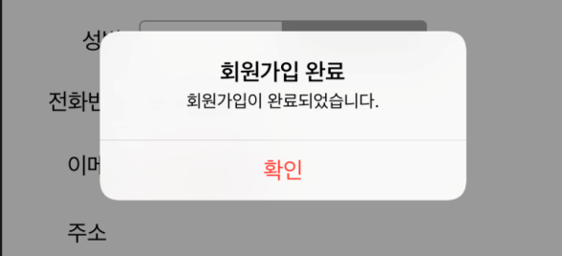
IOS(Join)
Web&App Project
Our Meal
By Java King
각 TextField 별 event 처리

Slide 56
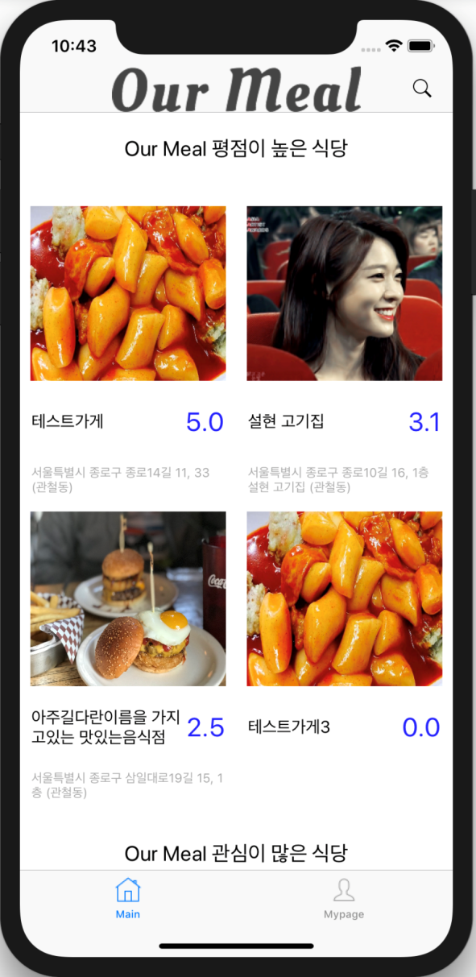
IOS(Main)
Web&App Project
Our Meal
By Java King
CollectionView를 사용하여
Section 별
Header 영역에 카테고리 명,
Cell 영역에 Thumbnail 형태의
가게정보를 구현

Slide 57


IOS(Store Page)
Web&App Project
Our Meal
By Java King
(1)
(1) CollectionView의 Header 영역에 가게
정보 구현
(2) kakaomap API를 사용하여 DB에 저장되어있는 가게 주소를 WebView로 구현
작성된 리뷰들은 Cell을 사용하여 구현
(2)

Slide 58

IOS(Store Page)
Web&App Project
Our Meal
By Java King
TableView를 사용하여
메뉴 정보출력

Slide 59



IOS(My Page)
Web&App Project
Our Meal
By Java King

Slide 60



IOS(My Page)
Web&App Project
Our Meal
By Java King

Slide 61


IOS(My Page)
Web&App Project
Our Meal
By Java King

Slide 62

IOS(My Page)
Web&App Project
Our Meal
By Java King

Slide 63
- END -

